Slide 1

U.S. and Canada
Cross-Border Transfer Pricing
ICPA Fall Conference
October 24, 2017
George Tuttle III
Darrel Pearson

Slide 2

Introductory Remarks (Transfer Pricing)
“Transfer pricing” (TP) refers to setting the price for goods, services, and intangibles transferred within an organization
Customs professionals not always consulted on TP model used (traditionally considered an income tax matter)
Increasing border enforcement means that companies must also consider customs requirements
  Customs valuation is based on the legally defined “price paid or payable” which varies by jurisdiction
  “Transfer price” for income tax purposes will be different than “value for duty” calculated for customs purposes
  Income tax-driven transfer pricing models are not necessarily sufficient for compliance with customs valuation
  For services and intangibles, practices for that do not meet customs requirements can result in their inclusion in the dutiable value of imported goods
Base Erosion and Profit Shifting (“BEPS”) – G20 initiative to “rewrite rules of corporate international taxation to eliminate “gaps”
  Action items include: Aligning TP Outcomes with Value Creation, TP Documentation and Country-by-Country Reporting
The challenge is to develop a unified approach for income tax and customs that complies with the different requirements in all countries where your company does business

Slide 3
Agenda
    Customs Valuation: Basic Concepts (Transaction Value Method)
    Treatment of Related Parties (Establishing Lack of Influence)
    Importance of Contemporaneous Documentation
    Transfer Pricing Adjustments (Requirements to Amend)
    Treatment of Royalties and Licencing Fees
    Subsequent Proceeds
    Management and Administration Fees
    Best Practices for Compliance Managers and In-House Counsel

Slide 4
1. Customs Valuation: Basic Concepts (Canada)
“Transaction Value” method
The preferred method of valuation for imported goods is the Transaction Value method
  followed by alternate methods if the Transaction Value method cannot be applied
Three requirements must be met for the Transaction Value method to apply:
  The goods were sold for export to Canada;
  to a purchaser in Canada, and
  the price paid or payable can be determined.
    "price paid or payable" = all payments made or to be made in respect of the goods by the purchaser to the vendor (directly or indirectly)
    Once the price paid or payable is ascertained, specific adjustments must be made under Canada’s Customs Act
    Transaction Value (TV) = Price Paid or Payable +/- Adjustments
However – The Transaction Value method cannot be used when the price paid or payable is influenced by the relationship between the vendor and the purchaser

Slide 5
2. Treatment of Related Parties (Canada)
Arm’s Length Principle
For related parties, Transaction Value method can only be used if the companies can establish that the relationship had no effect on the selling price (“arm’s length principle”)
Consequence of non-arm’s length price is that an alternative valuation method must be used
  Alternative methods (identical or similar goods, deductive value, computed value, residual value) are more complicated to apply
  Alternative methods often result in higher values for duty (and therefore more customs duties and VAT/GST)
Establishing Lack of Influence
Examine how the price was determined between the parties – maintain evidence showing that the relationship between the parties had no effect on the selling price
Two options for establishing the acceptability of the transaction value:
  Examining the circumstances surrounding the sale to determine whether the relationship influenced the price; or
  The importer demonstrating that the price closely approximates a "test value" which are equivalent to OECD comparables (identical or similar goods, deductive value, computed value)

Slide 6
3. Importance of Contemporaneous Documentation (Canada)
Importer's conclusion that the price is acceptable should be supported by factual evidence
Process for establishing related party price may be reflected in various kinds of documents (including written agreements)
  transfer price agreement, transfer pricing study, report, or advance pricing arrangement
Importer must demonstrate (with corroborating evidence) that the agreement relied on existed and was in effect at the time of importation, and the value for duty was based on that agreement
A transfer price study or agreement on its own is insufficient
  Transfer price agreement submitted by the importer may be a good source of information if it contains relevant information about the circumstances surrounding the sale
  Canadian Border Services Agency (CBSA) describes transfer price agreements as “an acceptable starting point for determining the value for duty of imported goods”
  The importer must maintain supporting materials, including all applicable customs, accounting, and tax documents

Slide 7
4. Transfer Pricing Adjustments (Canada)
Transfer pricing based on estimates are acceptable, but if transfer pricing is adjusted there may be post-adjustment obligations
Upwards adjustments of transfer prices:
  Canadian customs authorities require the importer to declare such higher amount and pay duty on the difference
  Increases to transfer prices require correction within 90 days of when the importer had “reason to believe” that declared value for duty was incorrect
Downward adjustments of transfer prices:
  Canada historically denied refund requests stemming from downward transfer price adjustments
  Canada changed its policy (in January 2015) to allow customs duty refunds for qualifying downward transfer price adjustments by importers
  Refunds are not automatic – Documentation will need to be provided and will be tested to verify eligibility, and to ensure there was a transfer pricing agreement in effect at the time of importation

Slide 8
5. Royalties and Licence Fees (Canada)
Royalties and/or licence fees must be added to the price paid or payable only if the following three factors are met:
    The payment is a royalty or licence fee;
    it is in respect of the goods; and
    it is a condition of sale of the goods (must be explicit).
If the purchaser’s refusal to pay the royalty or licence fee would entitle the vendor to refuse to sell the licenced goods or to repudiate the sales contract, then the royalties or licence fees are dutiable
Bundling:
  Bundling of payments for goods, services, royalties, etc. may result in the requirement to include otherwise non-dutiable costs in the value for duty (e.g., royalties)
  Transfer prices should therefore be "unbundled" for customs purposes
    Goods should be priced separately from non-dutiable payments such as royalties, management and administration fees, etc

Slide 9
6. Subsequent Proceeds (Canada)
Payments made to the vendor (or a third party) after the importation of goods may have to be included in the value for duty of the imported goods as part of the price paid or payable
“Subsequent proceeds” are a type of post-importation payment that must be added to the price paid or payable, if:
  The payments accrue directly or indirectly to the vendor of the goods; and,
  the payments are based on, or are result of, the resale, disposal or use of the goods in Canada:
    for valuation purposes, “resale” means the further sale of imported goods by the purchaser to someone else
    "disposal or use" means the sale, pledge, giving away, utilization, consumption or any other disposition of a good
Customs authorities anticipate that some payments made after importation are remitted separately from the payment for the goods themselves, and importers often do not include them in the value for duty
However – if the conditions above are met these payments must still be added to the value for duty under the Transaction Value method

Slide 10
7. Management or Administration Fees (Canada)
Payment for services such as planning, direction, control, coordination, systems or other functions at a managerial level (e.g. departments such as legal, accounting, data processing, employee relations) can be excluded from the price paid or payable, only if :
  The services are rendered for the operation of the business in Canada
    Maintain evidence to establish the nature of the services
    Maintain evidence to prove that the services were provided for the operation of the business in Canada
  The amount of the charge is an arm’s length charge
    Customs officials are more likely to challenge excessive charges - Should not exceed industry standards
    Allocation basis should result in costs being shared in proportion to the benefits received
      i.e. based on time spent on duties performed for each subsidiary, actual use of services, etc.
    If the amount of the charge is determined after the fact, it is more likely to be challenged by the CBSA
  The services provided are justified for the operation of the business in Canada
    Must be able to establish that a charge is justified for the specific service performed – that the services actually delivered a benefit to the importer in Canada
Customs authorities in Canada take issue with a company charging management fees based on a percentage of net sales, since this allocation will not necessarily reflect real costs. The company must be able to demonstrate that the amount of the charge is reasonable for the services rendered and reflects actual usage

Slide 11
8. Best Practices for Compliance Managers and In-House Counsel
  Unified approach to transfer pricing (income tax and customs valuation should both be taken into account)
  Sufficiently granular transfer pricing studies (but not enough on their own)
  Maintain detailed transfer pricing studies, legal agreements, customs/shipping paperwork, tax filings, commercial documents, accounting records
  System of monitoring and correction for adjustments
  Unbundling of dutiable from non-dutiable expenses (legal agreements covering purchases of goods, management services, royalties, and other related party payments)
  Allocation of management or administrative fees based on usage

Slide 12

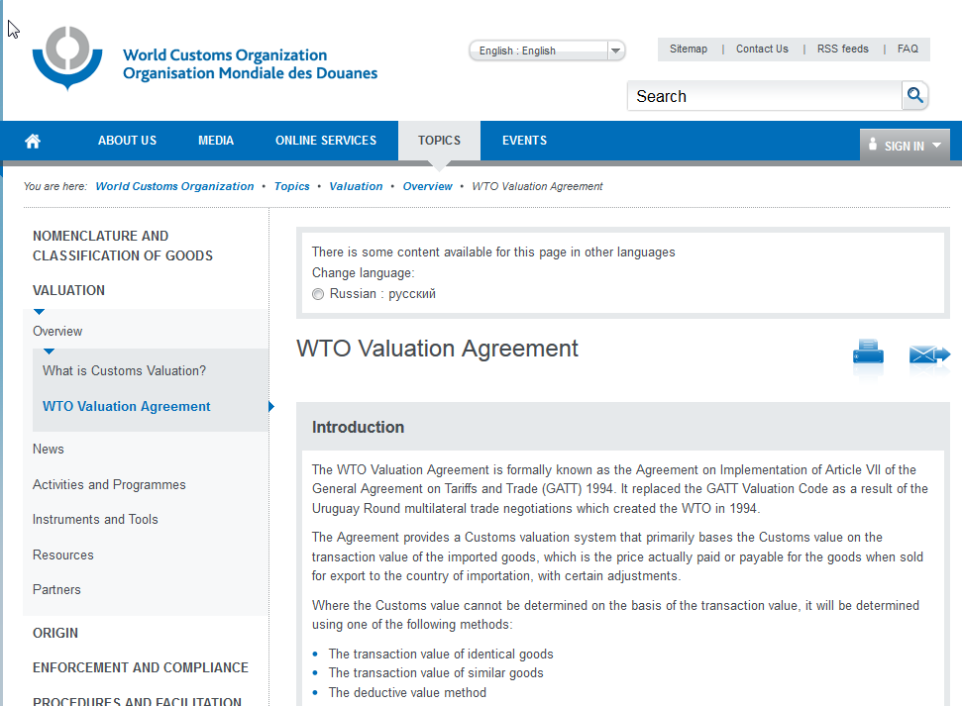
WTO – Customs Valuation Agreement
WTO --International body of 160 plus countries
Establishes uniform guidelines for valuation of imported goods
Most but not all participants agree to follow Article VII Rules
Publishes Guidelines and interpretations of value rules
Each participating country adopts the rules through domestic legislation
Generally free to apply and interpret rules
http://www.wcoomd.org/en/topics/valuation/overview/wto-valuation-agreement.aspx

Slide 13
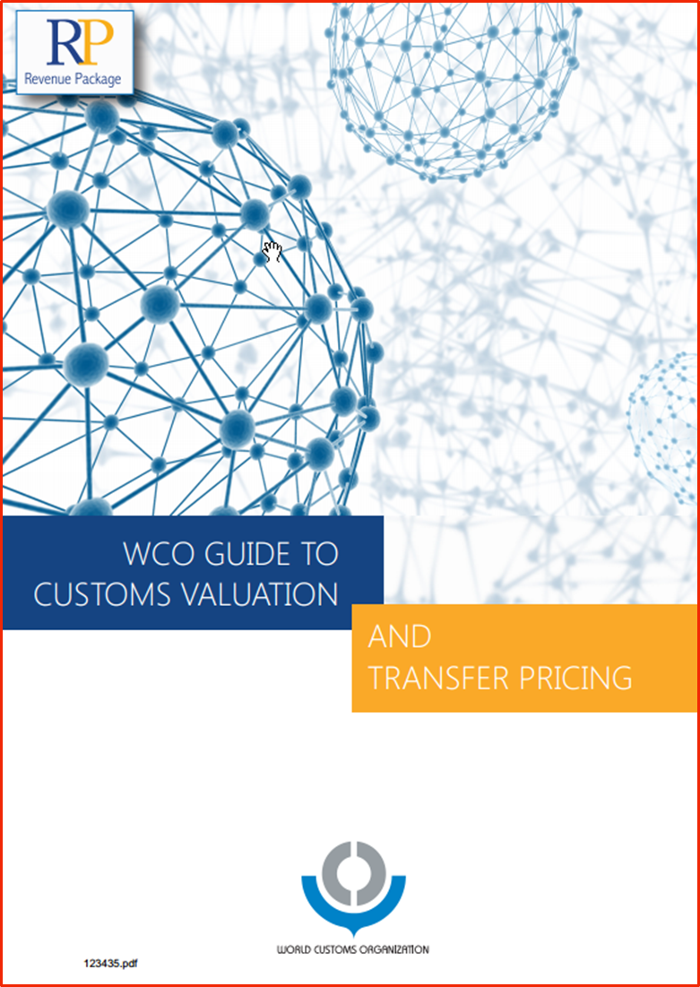
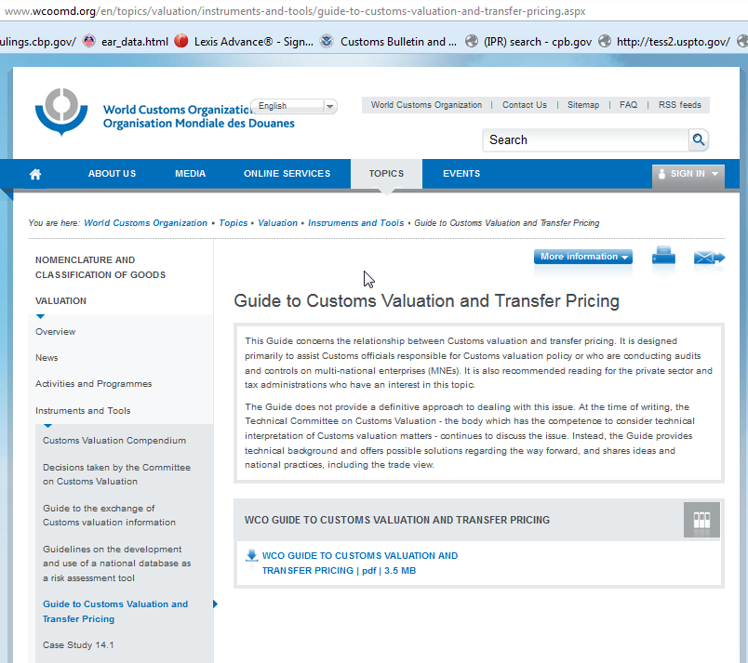
WCO Transfer Pricing Guidance

Slide 14
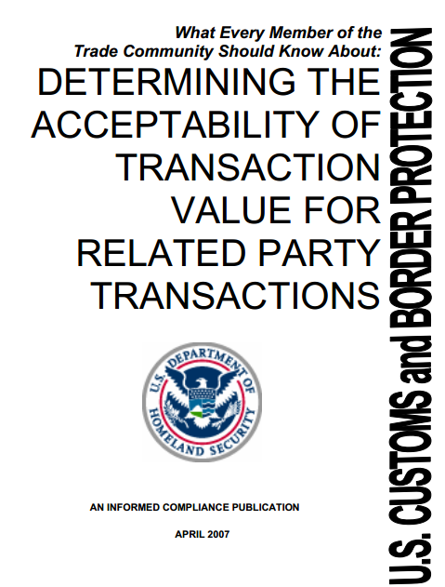
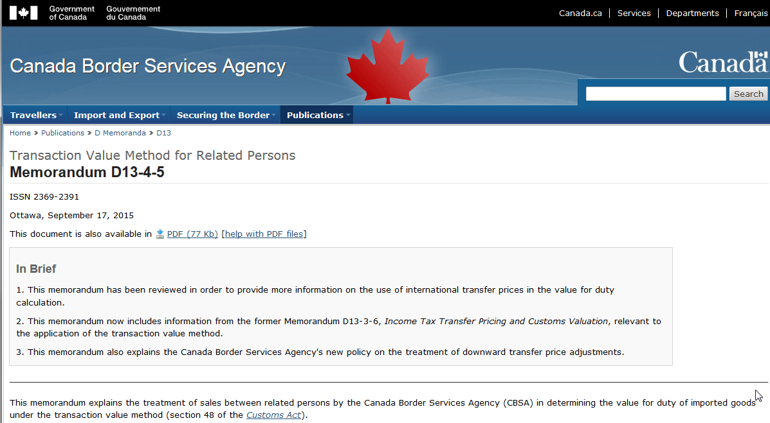
Transaction Value -- US vs. Canada
http://www.cbsa-asfc.gc.ca/publications/dm-md/d13/d13-4-5-eng.html

Slide 15
1. Customs Valuation: Basic Concepts
WTO Article 1
  1. The customs value of imported goods shall be the transaction value, that is the price actually paid or payable for the goods when sold for export to the country of importation … provided:
  (d) buyer and seller are not related, or where the buyer and seller are related, that the transaction value is acceptable for customs purposes under the provisions of paragraph 2.
  2. (a) … the fact that the buyer and the seller are related within the meaning of Article 15 shall not in itself be grounds for regarding the transaction value as unacceptable.
  In such case the circumstances surrounding the sale shall be examined and the transaction value shall be accepted provided that the relationship did not influence the price.

Slide 16
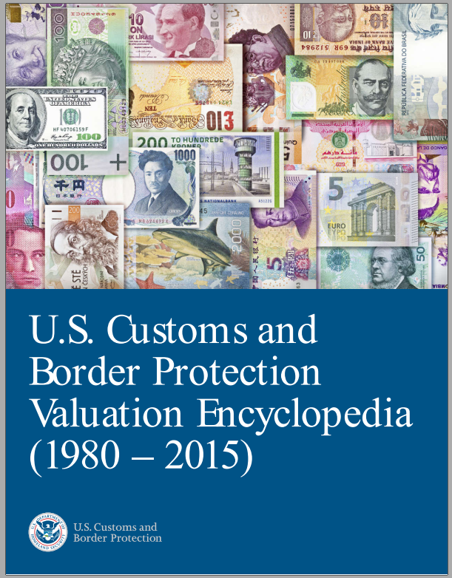
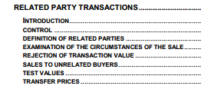
1. Customs Valuation: Basic Concepts (US)
Transaction Value requires a “sale” between two or more parties for exportation to the United States.
  Defined as:
  “transaction value of imported merchandise is the price actually paid or payable . . . when sold for exportation to the United States”
  Plus any statutory additions, such as assists, royalties, proceeds of sale, etc.
19 USC 1401a(b)
19 CFR 152.103
CBP Informed Compliance Publication Valuation Encyclopedia

Slide 17
1. Customs Valuation: Basic Concepts (US)
When are parties related? (19 U.S.C. 1401a(f))
  (A) Members of the same family.
  (B) Any officer or director of an organization and such organization.
  (C) An officer or director of an organization and an officer or director of another organization, if each such individual is also an officer or director in the other organization.
  (D) Partners.
  (E) Employer and employee.
  (F) Any person (i.e., entity) directly or indirectly owning, controlling, or holding with power to vote, 5 percent or more of the outstanding voting stock or shares of any organization and such organization.
  (G) Two or more persons directly or indirectly controlling, controlled by, or under common control with, any person (i.e., sister companies).

Slide 18
2. Treatment of Related Parties (US)
What is a “sale”?
  A "sale" is defined as a transfer of ownership in property from one party to another for a price or other consideration.
    J.L. Wood v. United States, 62 CCPA, 25, 33, C.A.D. 1139, 505 F.2d 1400, 1406 (1974)
    VWP of America, Inc. v. United States, 175 F.3d 1327 (Fed. Cir. 1999)
  Did the sale “cause” the export the United States?
  (sometimes, there is more than 1 sale that causes the goods to be exported to the U.S.) (Nissho Iwai American Corp. v United States, 16 C.I.T. 86, 786 F. Supp. 1002)

Slide 19
2. Treatment of Related Parties (US)
19 USC 1401a(b)(2) Related Party Rule
Transaction value between a related buyer and seller is acceptable if:
  the transaction value of the imported merchandise closely approximates a
  test value (i.e., TV of identical or similar merchandise, computed or deductive value)
    Test values requires an appraisement of an entry at the test value, which never happens.
  The “circumstances of sale” indicates that the relationship did not influence the price

Slide 20

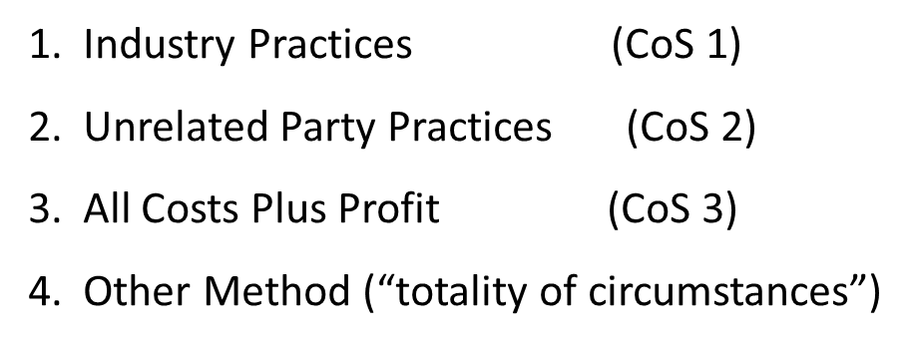
2. Establishing Circumstances of Sale (US)

Slide 21
2. Establishing Circumstances of Sale (US)
Circumstances-of-sale test (COS)
Appraisement . . . pursuant to the transaction value method will be acceptable, even between related parties, if the price is settled:
  "in a manner consistent with the normal pricing practices of the industry in question (COS-1), or
  the way the seller settles prices for sales to buyers who are not related to him.” (COS-2),
  Using the “all costs plus profit” method (COS-3) (CBP -- COS-3 “is the most objective method of meeting the circumstances of sale test when there are no sales to an unrelated buyer.” )
  Other method, such as an acceptable transfer pricing agreement.

Slide 22
3. Documentation - Acceptability of Transfer Pricing Agreements (US)
Related Parties may have:
  Informal understanding on how prices are set
  Written agreement
  Prices may be based on a “transfer pricing study”
  Study may look at how other companies do business, allocate costs, and identify and allocated profits.
  Advanced Pricing Agreements with one or more taxing authorities in affected jurisdictions
Transfer prices can be:
  Fixed, or
  adjusted after importation to change profit and cost allocations
    Requires a two part analysis (is TP acceptable TV? Are adjustments acceptable? )

Slide 23
3. Acceptability of Transfer Pricing Agreements (US)
HQ 546979, August 30, 2000
  “While the goal of both the [Customs Value Law] and section 482 of the Tax Code is to ensure that the transactions between related parties are at arms length, the method of making that determination is different under each law.”
  “Customs approach to related party transactions differs from the IRS approach . . . the [IRS] methods review profitability on an aggregate basis, not a product by product basis.”
  “Customs generally analyzes related party transactions at a more detailed product by product level . . .”

Slide 24
3. Acceptability of Transfer Pricing Agreements (US)
April 2007, CBP Informed Compliance guide on: TRANSACTION VALUE FOR RELATED PARTY TRANSACTIONS:
  “The mere fact that the importer has satisfied the requirements of Section 482 IRC, either through an APA or otherwise, does not mean that transaction value is acceptable under 19 U.S.C. §1401a.”
  “It is still necessary for the importer to analyze whether the related party sale satisfies the circumstances of sale test or the test value method … before making a value declaration . . .”
  “An importer that relies solely on an APA or transfer pricing study to conclude that transaction value is acceptable would not be exercising reasonable care.”

Slide 25
3. Acceptability of Transfer Pricing Agreements (US)
Are products covered by a TP study or APA comparable to the imported products at issue is an important consideration, i.e., same class or kind as the imported merchandise. See HQ H037375; HQ 547672, dated May 21, 2002.
The transfer pricing study should included companies in the same industry as the importer, including some competitors.
The methodology selected for use in a transfer pricing study is also relevant. See HQ 548482, July 23, 2004. CBP notes that CPM is the least relevant method for customs purposes. See HQ H219515 (October 11, 2012) (CPM = Comparable Profits Method)
Information in a transfer pricing study may be relevant in examining circumstances of the sale, but the weight to be given this information will vary depending on the details set forth in the study.
CBP does not consider the industry in question to consist of other functionally equivalent companies if those companies do not sell goods of the same class or kind. See HQ 548482, dated July 23, 2004.
CPM compare the profitability of the tested party to that of comparable companies that engage in similar business activities under similar circumstances

Slide 26
4. Transfer Pricing Adjustments (US)
“Transaction value” must be fixed at time of importation or subject to a fixed formula
If a transfer price is subject to post importation adjustments and the adjustments are within the control of either the buyer or the seller:
  then transaction value cannot be applied and the merchandise must be appraised using one of the other valuation methods in 19 U.S.C. §1401a.
Transfer Pricing Agreement may constitute a “fixed formula” if it meets the conditions of HQ W548314, May 16, 2012

Slide 27
4. Acceptability of Transfer Pricing Adjustments (US)
  HQ W548314, May 16, 2012; HQ H228298, 11-12-2015
  (1) A written “Intercompany Transfer Pricing Determination Policy” is in place prior to importation and the policy is prepared taking IRS code section 482 into account;
  (2) The U.S. taxpayer uses its transfer pricing policy in filing its income tax return, and any adjustments resulting from the transfer pricing policy are reported or used by the taxpayer in filing its income tax return;
  (3) The company’s transfer pricing policy specifies how the transfer price and any adjustments are determined with respect to all products covered by the transfer pricing policy for which the value is to be adjusted;
  (4) The company maintains and provides accounting details from its books and/or financial statements to support the claimed adjustments in the United States; and,
  (5) No other conditions exist that may affect the acceptance of the transfer price by CBP.

Slide 28
5. Transfer Price Additions: Royalties and License Fees (US)
Royalty & License Fee Payments
    (D) any royalty or license fee related to the imported merchandise that the buyer is required to pay, directly or indirectly, as a condition of the sale of the imported merchandise for exportation to the United States
  General Notice, Dutiability of Royalty Payments, Vol. 27, No. 6, Cust. B. & Dec., February 10, 1993:
      Three factors are relevant in assisting in determining whether royalty payments are related to the imported merchandise and a condition of sale:
        Is the imported merchandise manufactured under patent?
        Is the royalty involved in the production or sale of the imported merchandise and?
        Can the importer purchase the product from the supplier without paying the fee?

Slide 29
5. Royalties and License Fees (US)
Royalties or license fees for patents or Intellectual Property covering a process to manufacture imported merchandise generally will be dutiable.
Payments made by the buyer to a third party for the right to:
  Distribute or resell imported merchandise is generally considered a selling expenses of the buyer and will not be added to the price for the imported merchandise unless:
  The payments are a condition of the sale of the merchandise for exportation to the United States. (what does licensing agreement say???)

Slide 30
5. Royalties and License Fees (US)
HQ H077419, April 05, 2011
  The fact that the royalty payments are made to an unrelated third party is not entirely determinative.
  Customs’ position is that royalties will be dutiable, even if paid to third parties, if they constitute a condition of the sale for exportation.
    Under this arrangement, [importer] pays Licensee a royalty fee of 7% of the F.O.B./commercial invoice value based on the quantity of footwear exported from the factory to [importer] that bear the subject trademark.
  Payments based on the number of units sold or resold in the U.S. is “not relevant to determining the dutiability of the royalty payment.”
  Royalty payments and license fees are a condition of sale when they are paid on each and every importation and are inextricably intertwined with the imported merchandise.

Slide 31
6. Subsequent Proceeds (US)
  Transaction Value Additions
    (E) proceeds of any subsequent resale, disposal, or use of the imported merchandise that accrue, directly or indirectly, to the seller.
    Royalty or license fees paid to Supplier or a party related to Supplier for rights to use trademark on imported goods sold in U.S.
    Profit sharing or Profit splitting agreements with foreign party or party related to seller is a “proceed of subsequent resale”
    Example: U.S. Pharmaceutical importer agrees to assist develop, import, and market drug in U.S., and agrees to split profits on resale with foreign formula holder after deduction of costs to produce and distribute.
    Transfer of profit split is an “addition to transaction value.”

Slide 32
Best Practices for Compliance Managers and In-House Counsel
Summary
  The existence of a transfer pricing study or APA does not, by itself, eliminate the need for USCBP to examine the “circumstances of sale”
  Related party importers should have a “Customs Value” analysis done
  Does the Transfer Price Study meet the requirements of CBP?
  Does the RP transfer pricing policy provide for “End of Year” or “post entry adjustments”?
    If so, does the policy meet the requirements of a “fixed formula” under HQ W548314?

Slide 33

George Tuttle III
Attorney, Tuttle Law Offices
(415) 288-0428
george.tuttle.iii@tuttlelaw.com
1100 Larkspur Landing Circle, Suite 385
Larkspur, CA
94939
Darrel Pearson
Bennett Jones LLP
Senior Partner, Co-Head of International Trade
(416) 777-4811
pearsond@bennettjones.com
3400 One First Canadian Place
Toronto, Ontario
Canada M5X 1A4

