Slide 1




Canada Day Presentation
Presented to
Midwest Global Trade Association
November 13, 2019
Presenters
Darrel H. Pearson, Bennett Jones LLP
Jeff Fraser, Livingston International

Slide 2
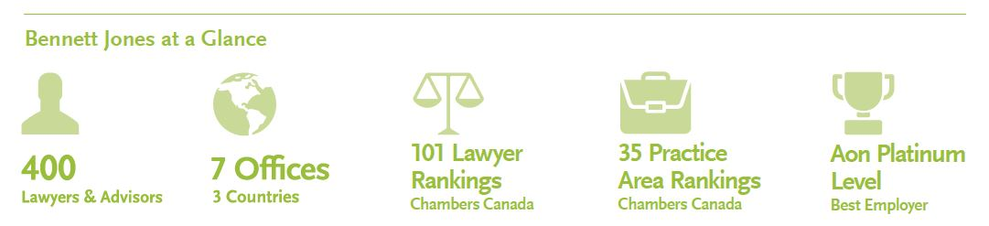
About Bennett Jones
The firm that businesses trust with their most complex legal matters
Clients benefit from:
  In-depth understanding of the industries that drive the Canadian economy
  Tailored, practical solutions designed to achieve desired business objectives
  Exemplary service delivered responsively and transparently
  Technology solutions that support efficient service delivery
  Best-in-class information security and ISO 27001 certification
  Canada’s most experienced integrated public policy and government relations team

Slide 3
About The Trade & Investment Group
Bennett Jones' International Trade and Investment group is positioned in all aspects of international trade and investment law. Our members have a proven track record of expertise in all of the elements that comprise the regulation of international business, including market access for goods, services, intellectual property and investment. Our practice is also fully integrated with the firm's extensive cross-border commercial, transactional, tax, banking and dispute settlement services.
Our experience spans domestic trade and investment laws, international rules and treaties, and international dispute settlement in trade and investment matters. Our depth allows us to offer the most comprehensive range of legal services in Canada in relation to international trade and investment regulation. Whether clients require advice on technical border issues or high-level trade policy, treaty negotiation or international relations matters, we are able to draw on our members' unparalleled expertise in international business regulation to provide timely, practical and informed advice.

Slide 4
About The Trade & Investment Group
We provide advice and represent matters involving:
  Customs and Border Administration
  Commodity Taxes
  Trade Remedies
  Trade Agreement, Policy and Negotiations
  Investment Treaties and Disputes
  Import and Export Controls
  Product Regulation and Standards
  Foreign Corrupt Practices
  Extraterritorial Measures and Claw-back Statutes
  Government Procurement and Bid Challenges
  International Trade and Energy

Slide 5
TRADE REMEDIES IN CANADA

Slide 6
DUMPING AND COUNTERVAILING DUTIES

Slide 7
AD/CVD - Canada’s Trade Measures
Goods imported into Canada generally only subject to customs duty and GST/HST
Certain imported goods may face additional duties for anti-dumping and subsidy reasons
Duties may be imposed if found to cause injury or retardation to a Canadian domestic industry
Issues addressed in Canada by the CBSA who administered SIMA and SIMR

Slide 8
AD/CVD - What is Dumping?
Dumping occurs when the normal value of imported goods exceeds their export price
The normal value of exported goods is established by considering:
  The domestic selling price of like goods;
  The selling price of like goods to importers in third countries;
  The cost of the exported goods plus a mark-up; or
  A ministerial specification

Slide 9
AD/CVD - Export Price
Export price is equal to:
  The lesser of the exporter’s sale price for the goods and
  The price at which the importer has purchased or agreed to purchase the goods
  Deductions from the EP include the costs, charges and expenses incurred in preparing the goods for shipment to Canada, or any federal or provincial duty or tax imposed on the goods paid by the exporter.

Slide 10
AD/CVD - What is a Subsidy?
A subsidy is a financial contribution by a by a country other than Canada that confers a benefit to persons engaged in production, manufacture, growth, processing, purchase, distribution, transportation, sale, export or import of goods provided it is specific to a business, industry or region.
Most subsidies are “actionable”, which may be subject to challenges if they cause adverse effects to interests of another country.

Slide 11
AD/CVD - Adverse Effects
Three types of adverse effects:
  Injury to domestic industry caused by subsidized imports in the territory of the complaining member
  Serious Prejudice arises as a result of adverse affects in the market of the subsidizing member
  Nullification or impairment of benefits accruing under the GATT 1994, which arises when the improved market access presumed to flow from a bound tariff reduction is undercut by subsidization
  Only injury can lead to a countervailing action

Slide 12
AD/CVD - Prohibited Subsidies
Subsidies that require recipients to meet certain export targets or to use domestic goods instead of imported goods are prohibited
They are specifically designed to distort international trade and are likely to hurt other countries
Where a subsidy is prohibited, countervailing duties can be imposed.

Slide 13
AD/CVD - Determination of Injury
Where the President of the CBSA makes a preliminary determination of dumping or subsidy, the final injury inquiry is conducted by the CITT
The role of the CITT is to conduct an inquiry to determine whether the dumping or subsidizing
  Has caused or is likely to cause injury to the domestic industry in Canada of like goods; or
  Would have cause injury or retardation except for the imposition of anti-dumping or countervailing duties

Slide 14
AD/CVD - Key CITT Considerations
What are the like goods?
What is the domestic industry?
Is there a casual link between dumping or subsidization, as the case may be, and injury or retardation.

Slide 15
AD/CVD - Material Injury
Considerations for what constitutes material injury includes:
  Price erosion or suppression;
  Low sales and market share;
  Reduced production and under-utilization of capacity;
  Reduced employment;
  Reduced investment; and
  Declining gross or net profitability

Slide 16
AD/CVD - Public Interest
Persons whose interests are adversely affected by a CITT finding of injury can request a public interest inquiry
These may include those engaged in production, purchase, sale, export or import of like goods, or any association whose purpose is to advocate the interests of consumers in Canada

Slide 17
AD/CVD - Liability for Anti-Dumping and Countervailing Duties
General rule is that importer of dumped or subsidized goods is solely liable for an applicable duty
Importer is defined in SIMA as the person who “is in reality the importer of the goods”.

Slide 18
AD/CVD – New Regulatory Measures
New regulatory amends concerning
  Particular Market Situation
  Related Party Input Dumping

Slide 19
AD/CVD – Particular Market Situation
Provides further scope to deal with cost distortions created by a “Particular Market Situation”
  Where government intervention results in price distortions or when factors such as significant macroeconomic volatility effects the prices and market input costs
  The CBSA can calculate an alternative price for goods through a “constructed costs methodology”
    = cost of production in country of origin + amount for administrative, selling and general costs and profits
  No definition in the SIMR for a “particular market situation”

Slide 20
AD/CVD – Related Party Input Dumping
Where inputs are acquired from associated persons, it may no longer be sufficient to demonstrate cost is based at arms-length price.
If an input used in production is acquired from an associated person and is a significant factor in production of the goods, the cost of the input will be the greater of:
  The price paid in respect of that Input by the exporter or producer to the associated person
  The cost incurred by the associated person in production of that input
  The price in the country of export of the same input

Slide 21
AD/CVD – Anti-Dumping Policy Changes
New policy changes make it “easier” for the CBSA to compare the price of goods imported into Canada with price of goods sold by same exporter to a different country.
Certain aluminum products added to Import Control Lists which require importers to cite the General Import Number (83) on CBSA import declarations
Global Affairs Canada can now ask certain importers to submit detailed reports on imports of steel which they feel would lead to “accurate tracking of imports and import patterns”.

Slide 22










AD/CVD - Current AD/CVD Measures in Canada
127
95
32
There is one current dumping investigation, for “Sucker Rods 2” against Argentina, Brazil, and Mexico, that will conclude on March 30, 2020.
Total cases
Dumping
Countervailing
25
22
30
12
3
Dumping & Countervailing for Same Good
5
1
5
1
2
4
1
4
1
Subsidy
4
1
1

Slide 23
SAFEGUARDS, SURTAXES, & MEASURES & COUNTERMEASURES

Slide 24
Safeguards - Steel Safeguards
Limits put on importation of goods of particular classes of steel
If imports exceeded these limits during a 50-day segment, the goods would be subject to surtaxes at the rate of 25% of their value for duty
Certain products later excluded because Canada did not have access to surtax-free sources of specific products

Slide 25
Safeguards - Provisional Measures Subject Goods
7 Steel Product Categories Subject to Provisional Safeguards
Energy tubular products
Heavy plate
Hot-rolled sheet
Pre-painted steel
Concrete reinforcing bar
Wire rod

Slide 26
Safeguards - Final Measures
Safeguards do not apply to goods originating from Chile, Mexico, Panama, Peru, South Korea, the U.S., or Israel.
2 Steel Product Categories Subject to Final Safeguards
Heavy plate
Stainless steel wire

Slide 27
Safeguards - New Measures for Safeguard Remedies
The Minister of Finance has brought into law Bill C-101, which temporary eliminates subsections 55(5) and (6) of the Customs Tariff
These provisions prevented Canada from immediately re-imposing further safeguard measures on products that were recently the subject of safeguards
New amendments repeal subsections until June 2021, respecting WTO Article 7 on moratoriums on safeguards.

Slide 28
U.S. S. 232 - Measures and Countermeasures
On May 31, 2018, the U.S. announced tariffs on 25% on imports of Canadian steel and 10% of Canada aluminum
Took effect on June 1, 2018
In response, Canada announced measures on up to $16.6 billion on imports of steel, aluminum, and other products from the U.S. representing the value of 2017 Canadian exports affected by the U.S. measures.

Slide 29
U.S. S. 232 - Measures and Countermeasures
The U.S. and Canada reached an understanding on May 17, 2019 to eliminate all tariffs on both sides
Canada had earned over $300 million in taxes from the first two months of the counter-measures
Joint statement committed to establish a process for monitoring steel and aluminum between the two countries and to prevent the transshipment of steel and aluminum.
Also agreed to only retaliate in affected sectors of future surtaxes.

Slide 30
U.S. S. 232 – Automotive Imports
President Trump announced a 180-day delay on the decision to impose tariffs on automotive imports under Section 232
U.S. will engage in negotiations with foreign counterparts to reduce automobile imports from those countries
Section 232 restrictions not imposed on uranium imports despite investigation by U.S. in July 2018

Slide 31
U.S. S. 232 – Uranium Products
Investigation initiated on Uranium on July 18, 2018
Secretary of Commerce submitted on April 14 a report on effects of import of uranium under s. 232
Secretary found that uranium is being imported into the USA in such quantities to threaten to impair national security
President Trump responded in July that he “did not concur at this time” with the findings
Canadian announcement that “Canadian uranium is not a threat to the national security of the United States”

Slide 32
North America, Europe and Asia, we simplify trade by navigating the vast nexus of government agencies, regulations, protocols, and updates that often overwhelm businesses trading internationally.
By continually investing in our people and technologies,
we give businesses the edge they demand in today's
highly competitive marketplace.

Slide 33
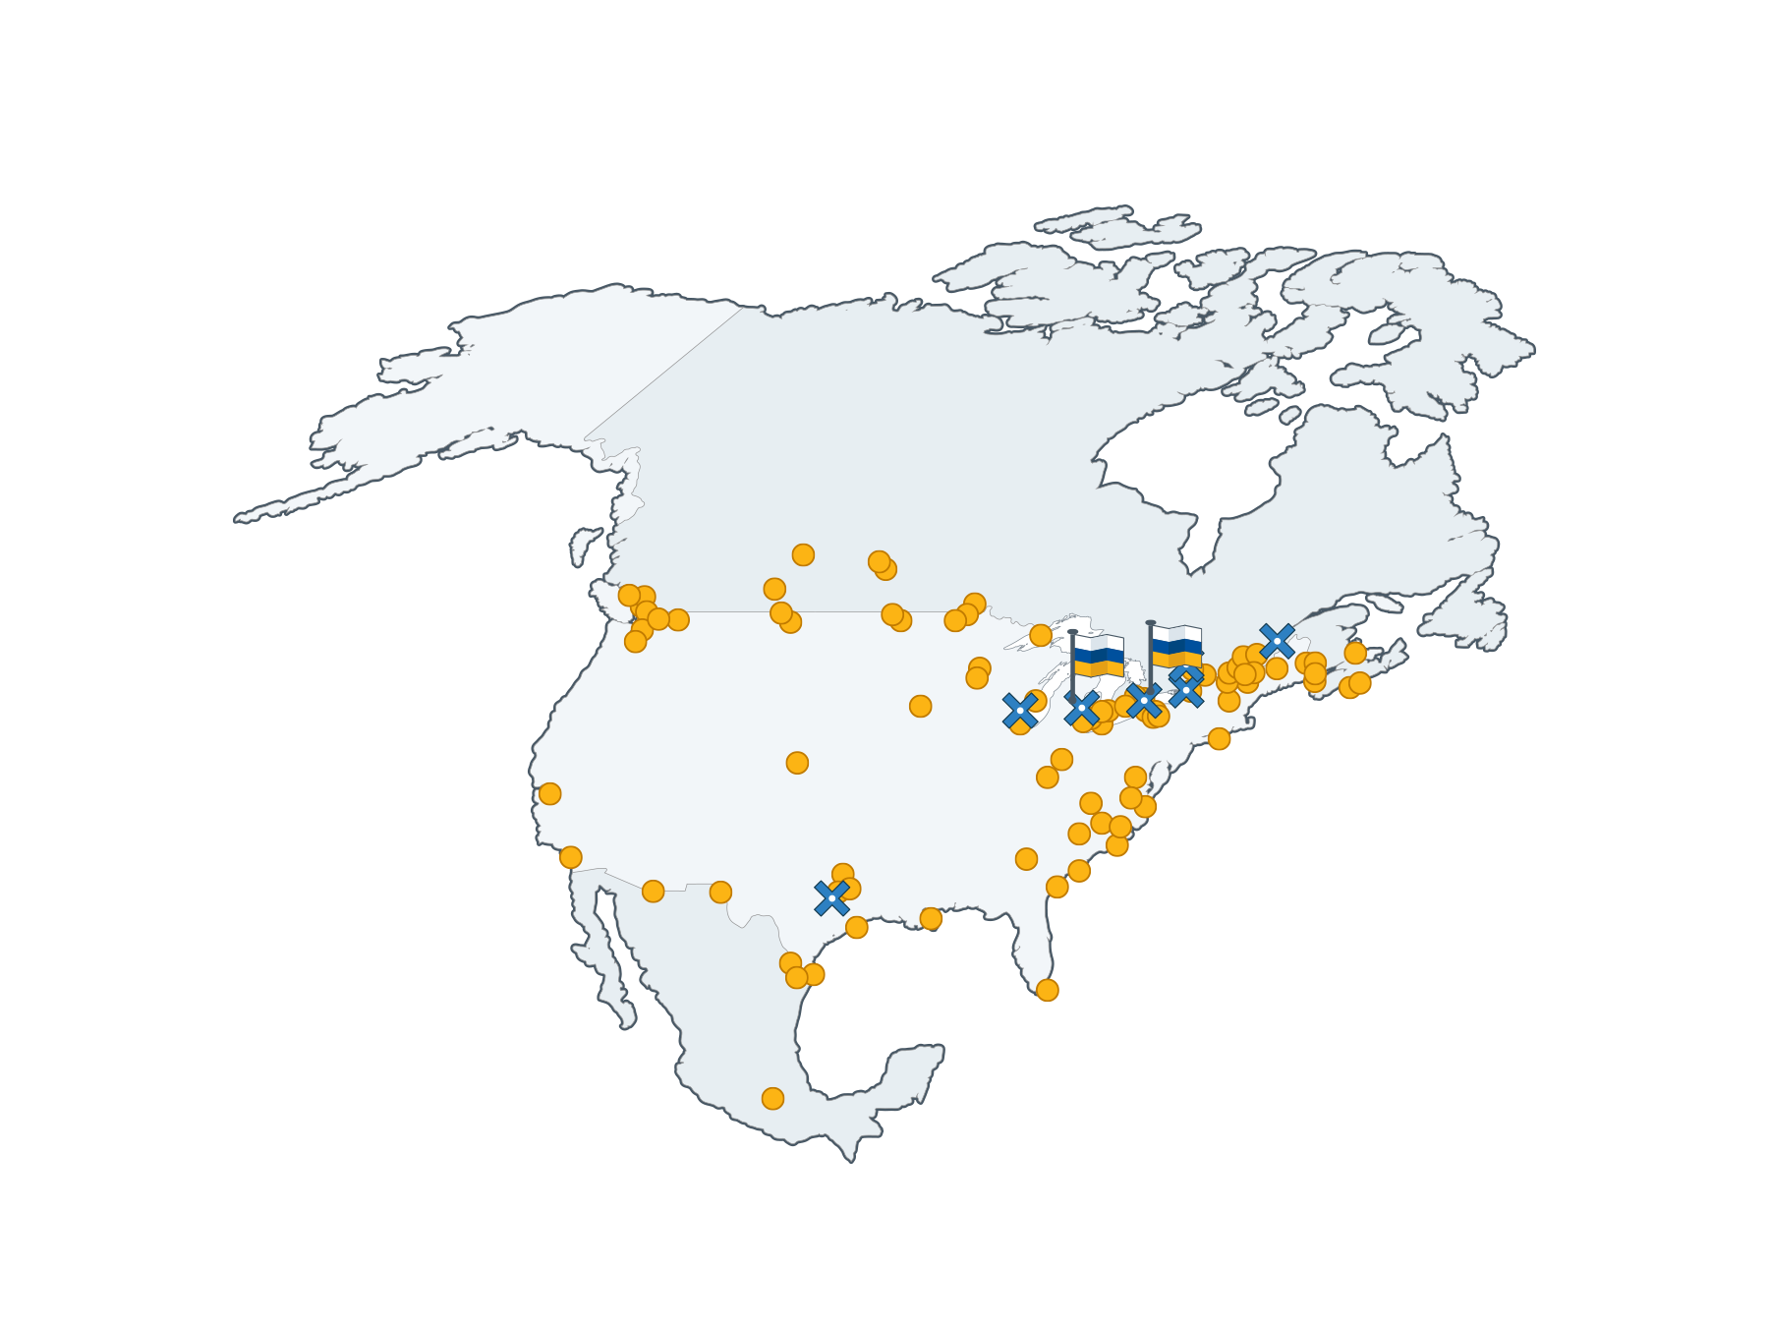

We’ve got you covered
More than 3,500 staff
work at over 110 key border points, seaports, airports and other strategic locations across North America and around the world.

Slide 34
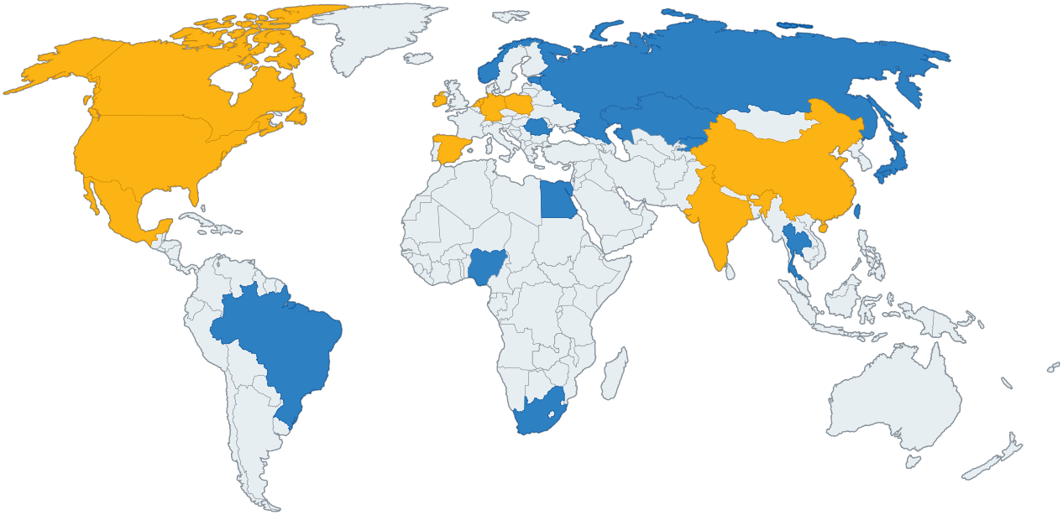
Livingston’s Global Footprint.
Livingston Global Trade Management locations
Livingston Consultants

Slide 35
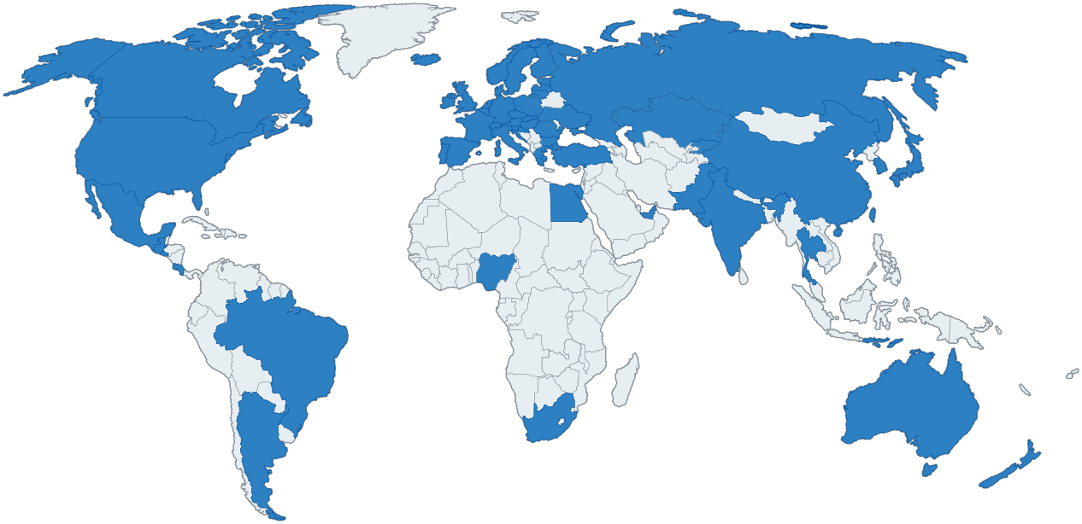
Livingston’s Global Footprint.
Trade Content Coverage: 50 Main countries and 31 Global organizations

Slide 36
Today’s Presenter
Jeff Fraser
Director, Global Trade Consulting
jfraser@livingstonintl.com
(800) 440-4351 ext. 48602

Slide 37
NAFTA and USMCA

Slide 38
Agenda – NAFTA and USMCA
Changes and similarities
Rules of Origin
Documentation

Slide 39
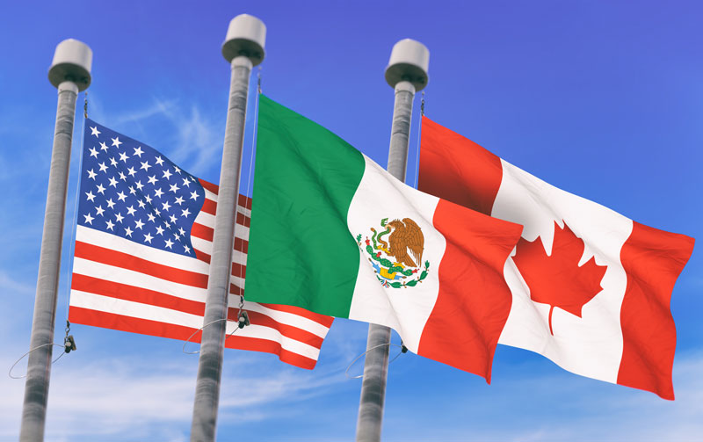
USMCA: Background
TEXT | NUMBER | PAGES
Chapters | 34 | 1,592
Annexes | 13 | 272
Side Letters | 14 | 44
Total Pages |  | 1,908

Slide 40
USMCA: Timing, Sunset and Withdrawal
Sunset Provision
  The terms of USMCA will remain in effect for a period of 16 years, at which time the parties can choose to revisit and/or renegotiate those terms, or withdraw from the agreement altogether
  USMCA is also subject to a joint review every six years, at which time the Parties may extend the agreement another 16 years
Withdrawal
  As with NAFTA, a Party may withdraw from this Agreement six months after it provides written notice of withdrawal to the other Parties
  In addition, a Party may withdraw from the agreement if another party enters into an FTA with a country it deems to be a non-market economy (e.g., China)

Slide 41
USMCA: Changes
De minimis is increased to 10% from NAFTA’s 7%
Recovered materials used in production of/incorporated into a remanufactured good are treated as originating
Regional value content calculation may include:
  Value of processing of non-originating materials undertaken in USMCA Territory
  Value of any originating material used in the production of the non-originating material undertaken in the territory
  Sets are originating only if each good in the set is originating and both the set and the goods meeting other applicable USMCA requirements
  Transshipped goods must remain in the USMCA Territory to remain originating

Slide 42

USMCA: Intellectual Property
Pharmaceutical companies can maintain patents on biologics for a 10-year term, there were no commitments in NAFTA
The term of copyright was extended from 50 years after an author’s death to 70 years
TOPIC | USMCA | NAFTA
Biologics | 10 Years | None
Copyright | 70 Years | 50 Years

Slide 43
USMCA: Rules of Origin and Restrictions
Good is wholly obtained or produced entirely in the USMCA Territory
Good is produced entirely in the USMCA Territory using non-originating materials, provided the good satisfies product specific rules of origin
The good is produced entirely in the USMCA Territory of one or more of the Parties exclusively from originating materials
Automobiles:
  Originating material must equal 75% (up from 62.5%) - staged
  70% of all steel, aluminum and glass must originate
  40% of an automobile and 45% of a light truck must be produced with an average labor rate of $16/hour
Dairy:
  Access an additional 3.6% of the market
  Remove restrictions on ultra-filtered milk into Canada

Slide 44
USMCA: Rules of Origin – con’t
Petrochemical (Ch 27 & 28-38):
  Chemical reaction rule – breaking and forming intermolecular bonds
  Note 4: For the purposes of determining whether or not a good of heading 27.09 is an originating good, the origin of diluent of heading 27.09 or 27.10 that is used to facilitate the transportation between Parties of crude petroleum oils and crude oils obtained from bituminous minerals of heading 27.09 is disregarded, provided that the diluent constitutes no more than 40 percent by volume of the good.
Textile:
  Yarn forward remains
Iron & Steel - staged:
  Tariff shift plus 70% by weight of materials
  RVC requiring 75% transaction value or 65% net cost

Slide 45
USMCA: De Minimis
United States - $800 USD
Mexico - $117 USD for customs and $50 USD for taxes
Canada - $150 CAD for customs and $40 CAD for taxes
Previous de minimis in Canada
  $20 – personal/commercial (Postal/Courier remission)
  $60 – gifts

Slide 46
USMCA: Documentation, Certificate of Origin
No prescribed format
Requirements
  Single shipment or blanket
  On invoice or other document
  Completed by importer, exporter, or producer
  Electronic/digital format is allowed
  Producer CO – based on having info, including documents
  Exporter CO – based on having info, including documents or reasonable reliance on producer’s written representation (such as a CO)
  Importer CO – based on having information, including documents
  Importer must have CO in possession at time of claim and make a statement forming part of the import documentation based on that CO

Slide 47
USMCA: Certificate Data Elements
Minimum Data Elements
  Indicate Importer, Exporter, or Producer CO
  Certifier – name, title, address, phone, e-mail
  Exporter – name, title, address, phone, e-mail (not required if producer)
  Producer – name, title, address, phone, e-mail (various or available upon request)
  Importer – name, title, address, phone, e-mail (must be in territory)
  Description and HS Tariff Classification
  Origin Criterion
  Blanket Period
  Authorized Signature and Date

Slide 48
USMCA: Documentation, Records
Records for preferential tariff treatment shall be maintained for a period of six years after the end of the year of importation (6+1):
  the documentation related to the importation, including the certification of origin that served as the basis for the claim;
  all records necessary to demonstrate that the good is originating, if the claim was based on a certification of origin completed by the importer; and
  the information, including documents, necessary to demonstrate that the good certified as originating did not undergo further production or any other operation other than unloading, reloading, or any other operation necessary to preserve it in good condition or to transport the good into the territory of the importing Party, if applicable.

Slide 49

USMCA: Dispute Resolution
NAFTA Chapter 20, country-to-country dispute resolution mechanism maintained
NAFTA Chapter 19, anti-dumping/countervailing duty dispute-resolution mechanism maintained
NAFTA Chapter 11, investor-state dispute resolution mechanism (ISDS) eliminated between Canada and the United States

Slide 50
Other Canadian Free Trade Agreements

Slide 51
Agenda – Other Free Trade Agreements
CETA
CPTPP
Other Trade Agreements
U.S. – Canada – China: How do we fit together?

Slide 52
Canada-European Union Comprehensive Economic and Trade Agreement (CETA)
The EU is the worlds second largest economy and Canada’s second largest trading partner
98% of tariff lines duty free (up from 25% pre-agreement)
CPTPP – More than just a Trade Agreement
  Trade in goods
  Trade in services
  Eliminates trade (tariff and non-tariff) barriers
  Investment & government procurement
  Environmental protection
  Labor rights
Merchandise trade increased by 9.4% in the first year of implementation
Primary trade details found in the Protocol on rules of origin and origin procedures

Slide 53
Transport through a third country – Article 3.14
For a good that satisfies the requirements of Article 2, to remain originating it must meet the following criteria subsequent to production:
  Does not undergo further production or any other operation outside the territories of the Parties, other than unloading, reloading, or any other operation necessary to preserve it in good condition or to transport the product to the territory of a Party; and
  Remains under customs control while outside the territories of the Parties.
The storage of products and spitting of shipments may take place as long as they meet the above requirements
Proof of transport (Article 22)
  Carrier documents
  Customs control documents

Slide 54
Origin Declaration – Annex 2
.(Period: from___________ to __________(1))
The exporter of the products covered by this document (customs authorisation No ...(2)) declares that, except where otherwise clearly indicated, these products are of ...(3) preferential origin.
…………………………………………………………….................................
(Place and date)
...……………………………………………………………………...................(4)
(Signature and printed name of the exporter)
Cannot exceed 12 months
Will be:
  EU customs authorization number for approved exporters
  Blank if not an EU customs approved exporter
  Canadian Business Number
Reads Canada/EU (unless of Ceuta and Melilla)
Article 19.3 provides exceptions to a signature

Slide 55
Comprehensive and Progressive Agreement for Trans-Pacific Partnership (CPTPP)
The CPTPP is one of the largest trade agreements in the world comprised of 11 countries representing 495 million people and a combined GDP of $13.5 trillion
Strategically sets the terms of trade in the Asia-Pacific region
CPTPP – More than just a Trade Agreement
  Trade in goods
  Trade in services
  Eliminates trade barriers
  SME provisions
  Environmental protection
  Labor rights
Canada is the only nation to have a free trade agreement with all of the G7 countries.

Slide 56

CPTPP Participating Countries
Australia
Brunei *
Canada
Chile *
Japan
Malaysia *
Mexico
New Zealand
Peru *
Singapore
Vietnam
Entered into force December 30, 2018
  * = Country has not ratified the agreement

Slide 57
CPTPP – Tariff eliminations and reductions – Chapter 2
CPTPP eliminates almost all tariffs on originating goods
  Eliminates customs duties on most qualifying imports as of year one
  Remaining tariffs will be phased out over a 12-year period
Once the agreement is fully implemented, Canada will have duty-free access to CPTPP countries for
  94% of Canadian agriculture and agri-food products exports
  99% of Canadian industrial products exports
  100% of Canadian fish and seafood products exports
  100% of Canadian forest product export
Canadian exporters estimate tariff savings of $428 million per year
Note: De Minimis set at 10%

Slide 58
Transshipment – Article 3.18
Transshipment is allowed for originating goods as long the goods meet the criteria outlined in Article 3.18 and Article 3.24 of Chapter 3
In summary:
Goods must remain under customs control while outside the territories of the parties
They must not undergo any further production or any other operation other than unloading; reloading; separation from a bulk shipment; storing; labelling or marking
All the carrier documents including the customs documents must be available to the importing country

Slide 59
Certification of Origin – Article 3.2
Minimum Data Requirements – Annex 3B
1. Importer, Exporter or Producer Certification of Origin
2. Certifier
Provide the certifier’s name, address, telephone number and e-mail address.
3. Exporter
4. Producer
5. Importer
6. Description and HS Tariff Classification (6-digit level) of the Good
7. Origin Criterion (specify Rule of Origin)
8. Blanket Period (up to 12 months)
9. Authorized Signature and Date
I certify that the goods described in this document qualify as originating and the information contained in this document is true and accurate. I assume responsibility for proving such representations and agree to maintain and present upon request or to make available during a verification visit, documentation necessary to support this certification.

Slide 60

Additional FTAs
In force
  Israel - CIFTA (1997)
  Chile - CCFTA (1997)
  Costa Rica - CCRFTA (2002)
  Canada-Europe - EFTA - Iceland, Liechtenstein, Norway and Switzerland (2009)
  Peru - CPFTA (2009)
  Colombia - CCOFTA (2011)
  Jordan - CJFTA (2012)
  Panama - CPAFTA (2013)
  Honduras - CHFTA (2014)
  Korea - CKFTA (2015)
  Ukraine - CUFTA (2017)

Slide 61
Non-FTA Preferential Tariff Treatments
Australia Tariff - AUT
Commonwealth Caribbean Countries Tariff – CCCT
General Preferential Tariff - GPT
Least Developed Country Tariff – LDCT
New Zealand Tariff - NZT
  Preferential tariff treatments
  Simplified rules of origin
  Direct ship clauses
  No formal agreements signed between countries

Slide 62
China-U.S. Trade Dispute – Where does Canada fit in?
301 duties by country of origin and not export
Essential transformation required to change origin
  Repacking, dilution, labeling etc. does not change origin
  Change in origin does not require NAFTA qualification
  Origin determination country of origin specific
Direct ship to Canada
  Deconsolidate in a bonded warehouse
  eCommerce solutions for B2C shipments
Merge Asian shipments to Canada
  Co-packing Asian shipments
  Remember CPTPP direct ship rules

Slide 63
TAXES AND “DOING BUSINESS IN CANADA”

Slide 64
CUSTOMS ISSUES

Slide 65
Customs - Value for Duty
Value for duty must be declared on all goods imported to Canada in accordance with the valuation provisions of the Customs Act
Value for duty is the base figure on which duty you may owe on goods is calculated
Even if duty not owed, value for duty of goods must be established for proper taxes to be calculated.
Value for duty must be established by using one of six methods in sections 48 to 53 of Act, but transaction value method must be used when possible.

Slide 66
Customs - Transaction Value Method
Primary method of valuation – used when goods are sold for export to Canada to a purchaser in Canada.
Value for duty based on price paid or payable for imported goods with certain adjustments.
Following questions must be asked to determine whether importation can be valued under this method:
  Were the goods “sold for export” to Canada?
  Were the goods “sold to a purchaser” in Canada?
  Can the “price paid or payable” be determined?
  If the purchaser and vendor are related, can you demonstrate the relationship did not influence the price paid for the goods?

Slide 67
Customs - Purchaser in Canada
A purchaser will qualify as a purchaser in Canada either as:
  Resident individual or business
    For individuals this is a question of fact
    For businesses they must be “carrying on business in Canada” and “management and control of business has to be in Canada”
  A permanent establishment in Canada
    Most cases related to foreign parent who establishes a subsidiary in Canada but whose operations are not wholly managed in Canada
    Section 2 of the Value for Duty Regulations defines this as a “fixed place of business”
    Fixed place of business must be a) a place of business in Canada, b) a fixed business, and c) the business of the purchaser in Canada must be carried on through the fixed place of business
  Neither a resident nor a non-resident having a permanent resident

Slide 68
Customs - Transfer Pricing
Transfers of goods or services between Canadian corporations and non-arm’s length non-residents must be effect at an arm’s length price and terms and conditions.
Otherwise, Canadian tax authorities may enact adverse tax consequences for the Canadian corporation and non-resident.

Slide 69
Customs – Adjustments and Subsequent Proceeds
Transfer Price Adjustments may be necessary and declared for a price to remain uninfluenced. Corrections may lead to more duties or a refund.
Subsequent proceeds refers to the value of any part of the proceeds of any subsequent resale, disposal or use of the goods by the purchaser
Subsequent proceeds must be added to the price paid or payable and form part of the transaction value of the goods

Slide 70
Customs - Tariff Classification
Tariff Classification is key for:
  Duty rate
  Free trade tariff treatment entitlement
  Availability for duty relief
  Anti-dumping/countervailing measure applicability

Slide 71
Customs - Tariff Preference
Conditions for goods to benefit from duty-free or reduced tariff under preferential treatment:
  The goods must be eligible
  The importer must possess valid proof of origin
  The goods must be shipped directly from the beneficiary country with or without transshipment
  Shipping terms: Impact on preference and valuation

Slide 72
Customs – Registration and Recordkeeping
Before importing commercial goods into Canada, a business or individual needs a Business Number (BN) issued by the CRA
Everyone who is involved in a commercial activity must keep records
Records include all invoices, shipping records, proof of origin, advance customs rulings, sale or other disposal of goods, and any adjustments to the value of the goods
Records can be maintained at your place of business in Canada, or at your customs broker or outside of Canada with written CBSA authority

Slide 73
Customs – Registration and Recordkeeping
Before importing commercial goods into Canada, a business or individual needs a Business Number (BN) issued by the CRA
Everyone who is involved in a commercial activity must keep records
Records include all invoices, shipping records, proof of origin, advance customs rulings, sale or other disposal of goods, and any adjustments to the value of the goods
Records can be maintained at your place of business in Canada, or at your customs broker or outside of Canada with written CBSA authority

Slide 74
GST/HST

Slide 75
GST/HST - Registration
NRIs must register if 1) they are carrying on business in Canada and 2) worldwide revenue is more than $30,000
Registration is important for claiming input tax credits (ITCs)
Recovery of GST paid or payable on goods imported for use in the course of commercial activities available

Slide 76
GST/HST - Security Deposit Required
Initial Amount – 50% of estimated net tax during the 12-month period after GST/HST registration
Subsequent Years – 50% of actual net tax for the previous 12-month period

Slide 77
GST/HST - Obligations After Registration
Filing returns (annual, quarterly, monthly)
Collect and remit tax from customers
Registering for provincial sales tax where applicable (HST in ON, NB, NFL, PEI, NS, no HST in BC, SK, MB, QC)
No provincial registrations required if registered for a GST/HST program account with the CRA

Slide 78
GST/HST - Recordkeeping
Failing to comply with a CBSA request for records may attract a peantly
Records that must be maintained can be divided into two types:
  Type A – Records required to facilitate release and accounting to CBSA for goods imported into Canada
  Type B – Records that support declaration of tariff classification and customs value, or are other records not of Type A but required by legislation
  Records must be kept in Canada, in either paper or electronic format, for six years

Slide 79
GST/HST – Type A Records
Type A records include:
  Canada Customs Form B3 accounting documents
  Commercial invoices (or Canada Customs Invoices)
  Cargo control documents
  Packing lists, bills of lading, freight invoices, and receiving documents
  NAFTA and other preferential tariff treatment Certificates of Origin
  Invoices for assists, commissions, purchases of goods, transportation costs, and all other payments associated with imports
  Import permits and TPL Exporter’s Certifications

Slide 80
GST/HST – Type B Records
Type B records include:
  Purchase orders
  Accounts payable journal
  Payment records and documents supporting payments for assists, commissions, purchases of goods, transportation costs, and all other payments associated with imports, such as bank statements, letters of credit, wire transfers, etc.
  Customs broker confirmation of entry and payment of duties and taxes
  Proof of payment received, when also acting as vendor of goods imported into Canada
  End-use certifications in support of end-use tariff declaration
  B2 amend form evidencing payment of duty and taxes on goods subsequently diverted from an end-use which permitted duty-free importation initially

Slide 81
GST/HST – Type B Records
Type B records (continued):
  Documents evidencing exportation of goods accounted for as temporary importations
  Records relating to the sale or disposal of the goods in Canada
  Buying and selling agency agreements
  Royalty and license fee contracts and/or agreements
  Purchase contracts and agreements establishing imported goods’ prices
  Contracts and/or agreements for payments to foreign companies for expenses other than for imported goods, such as management fees, research and development, tooling, etc.

Slide 82
INCOME TAX

Slide 83
Income Tax - Business Income
A non-resident who carries on business in Canada in a year or previous year will be subject to Canadian tax on the income derived from business that year.
In such cases, the income will generally be included in the non-resident’s “taxable income earned in Canada”
A “taxation year” for a non-resident corporation carrying on business in Canada may be any fiscal period chosen and regularly used.
Non-residents carrying on business in Canada will generally be subject to taxes levied by the province in which they have a permanent establishment.

Slide 84
Income Tax – Doing Business in Canada
Nonresidents planning to do business in Canada can do so directly (Canadian Branch) or Indirectly (Separate Canadian subsidiary corporation)
A subsidiary incorporated in Canada is deemed a Canadian resident for income tax purposes
A Canadian resident corporation generally must pay a federal income tax rate at 15% and provincial income tax in provinces which have a “permanent establishment”

Slide 85
Income Tax - Tax on Taxable Income
Certain types of income earned in Canada must be reported on a Canadian tax return.
The most common types of income include:
  Income from employment in Canada
  Income from a business carried on in Canada
  Taxable part of Canadian scholarships, fellowships, bursaries, and research grants
  Taxable capital gains from disposing of taxable Canadian property.

Slide 86
Income Tax - Canadian Taxation of Non-Residents
A person who is not a resident in Canada at any time in a taxation year will be subject to Canadian tax if at any time in that year or in a previous year the person:
  Was employed in Canada;
  Carried on a business in Canada; or
  Disposed of taxable Canadian Property

Slide 87
Income Tax - Taxable Income in Canada
Taxable Income earned in Canada of a non-resident for a taxation year includes the following source of income:
  Income from the duties of offices and employment performed by the non-resident in Canada
  Income from the duties of offices or employment performed by the non-resident outside of Canada if that non-resident in Canada at the time such duties were performed
  Incomes from business carried on by non-residents in Canada
  Taxable capital gains from the disposition of “taxable Canadian property”
  Recaptured capital cost allowance, to the extent not included in the income earned from a business carried on by that non-resident in Canada
  Taxable amounts arising from the disposition of an income interest in a trust resident in Canada

Slide 88
Income Tax - Carrying on Business in Canada
A non-resident will be liable for taxes on business income even if the non-resident has no permanent establishment in Canada
Common law rules for “Carrying on Business” – Most significant criteria for determining where business is being carried is the location where the contract that gave rise to profits earned by the business was concluded.
“Where operations take place from which the profits in substance arise”:
  Sales made under guise of carrying on business in Canada
  Utilization of Canadian bank accounts to which the proceeds of the sale were deposited
  Fact that profits derived from sales were at least momentarily in Canada
  Presence of official agent for the corporation in Canada who played an indispensable role in the transactions.
  If local distributor is an agent for the vendor, the vendor will be considered to be carrying on business in the distributor’s locale.

Slide 89
Income Tax – Section 253
A Non-Resident will be deemed to be carrying on business according to Section 253 of the Income Tax Act if the non resident:
  Produced, grew, mined, created, manufactured, fabricated, improved, packed, preserved or constructed in whole or in part, anything in Canada whether or not the person exported that thing without selling it before exportation;
  Solicited orders or offered anything for sale in Canada through an agent or servant, whether the contract or transaction was to be completed inside or outside Canada; or
  Disposed of:
    Canadian resource property;
    Property other than depreciable property that is a timber resource property; or
    Property other than capital property that is real property situated in Canada, including an interest or option in respect thereof, whether or not such property is in existence.

Slide 90
Income Tax – US-Canada Tax Treaty
Canada may levy tax on the business profits of a US resident, but only to the extent that such profits are attributable to a Canadian permanent establishment.
A US resident may be subject to Canadian tax on income derived from carrying on business in Canada through a permanent establishment, even if there is no permanent establishment in Canada at the time income is recognized for tax purposes.
A US resident will not be subject to Canadian tax on business profits unless the US resident has or had a permanent establishment in Canada, even if he or she is considered to be carrying on business in Canada for the purposes of the Act.

Slide 91
Income Tax – PE in US Tax Treaty
PE defined as meaning a “fixed place of business through which the business of a resident of Canada or the US is wholly or partly carried on”.
Any of the following constitutes a PE:
  A place of management;
  A branch;
  An office;
  A factory;
  A workshop;
  A mine;
  An oil or gas well; and
  A quarry or any other place of extraction of natural resources.
  This is not an “all-inclusive” definition.

Slide 92
Income Tax – What is not a PE (Tax)?
Solely doing the following does not constitute a permanent establishment:
  The use of facilities for purpose of storage, display, or delivery of goods or merchandise belonging to a US resident;
  Maintenance of a stock of goods or merchandise belonging to the US resident for the purpose of storage, display or delivery;
  Purchase of a stock of goods or merchandise belonging to the US resident for the purpose processing by another person;
  The purchase of goods or merchandise or the collection of information for the US resident; and
  Advertising the supply of information, scientific research, or similar activities, which have a preparatory or auxiliary character.

Slide 93
Compliance Considerations

Slide 94
Agenda – Compliance Considerations
Compliance Landscape – what is driving CBSA?
CBSA Audit Priorities
Trade Compliance Verifications
Duty Recovery
Differences between Canada and the United States

Slide 95
Auditor General’s Report 2017 - Highlights
Issue – 74% of audited imports had insufficient information to properly apply HS classification
Issue – 20% of imports are improperly classified
  Solution – have an HS classification review completed in advance that includes the descriptions to supply to CBSA
Current penalty regime (Administrative Monetary Penalty System or “AMPS”) is insufficient to encourage compliance; penalties should be increased
  Solution (importer) – ensure compliance upfront with education, a customs manual and period post entry reviews
  CBSA response – significant increase in AMPS penalties April 1, 2019
A four year refund application period is too long and should be reduced
  Solution – current importers should have a duty review completed now
  Solution – put a process in place to manage duty mitigation proactively

Slide 96
Audit Priorities
Published twice per year – January and July
Provides guidance on primary targets, not all targets
Details level of compliance
Three primary areas
  Tariff Classification verification
  Origin verification
  Valuation
Look for trends:
  “Parts” classifications
  “Other” not elsewhere specified classification
  New additions and additional rounds
https://www.cbsa-asfc.gc.ca/import/verification/menu-eng.html

Slide 97
How CBSA targets
Risk based audits
Classification
Valuation
Origin
Regional Targeting
District Operations
Headquarters
Plus random audits from headquarters
Classification
Valuation
Tariff Treatment
Export

Slide 98
Random Verifications
Valuation
  Related party transactions
  Deductions to the price paid or payable
Admissibility requirements
  Import Permits
Duty deferral and conditional relief
Exports
  Goods not declared (e.g. in transit through the U.S.)
  Controlled goods

Slide 99
Verification methodology
CBSA
Importer
AMPS risk
Initial contact letter
30 Days
Agent authorization
access to records
AMPS risk
Failing to provide records
Verification
Interim letter
30 days
Response to interim letter
Final letter
AMPS risk
RTB clear legislation
Directed T151 correctors
90 days “reason to believe”
Monitoring phase one
AMPS risk
RTB late correctors
Continued compliance
One year later
Monitoring phase two
AMPS risk
RTB non-compliance
Notes:
99

Slide 100
Types of audits
Focus on national priorities and risk based and random
  Single program
Tariff and NAFTA
  Sample of 5-10 imports - HS
  Questionnaire - NAFTA
  Desk audit
  Single program H.Q.
NAFTA or Valuation Audit
  In-depth audit
  Samples 5-10+ imports
  Audit team visits
  Monitoring program audit
  Desk review
  Follow-up audit
  Current focus of CBSA
  Post Export Verification
  Desk review
  Notification letter
  Findings/requirements
Notes:
100

Slide 101
Section 32.2 Customs Act – Reason to Believe
      “Reason to believe occurs when the importer has specific knowledge regarding the origin, tariff classification, value for duty, or diversion of the imported good that gives them reason to believe that a declaration is incorrect”
Legislative provisions that are evident and transparent
Detailed Adjustment Statements issued to importer
Final tribunal/court decisions involving importer
Information received from exporters/suppliers, etc.
Written communication addressed to importer/agent by CBSA (ruling, audit report etc.)
Final report from internal or external audit/review
Knowledge that the goods no longer qualify/comply with a condition of relief or restrictionf having reason to believe an error exists.
Notes:
101

Slide 102
Post audit corrections
Four year potential window for corrections
Correct ALL entries impacted by CBSA decision
Review and correct “like and similar” imported parts
90 days is NOT enough
  Ask for extensions (ASAP) *note: must be prior to 45 days from date of final report
Use the blanket amendment process where allowed
  Minimum 25 transaction per calendar year
  Cannot include Low Value Courier Shipments (LVS-C)
Reason to Believe = AMPS
Impact to future importations (Monitoring)
“SHARE” with your Broker
Appeal when warranted
Notes:
102

Slide 103
Penalty assessment process
If CBSA finds “reason to believe”
  Corrections to be made going back 4 years OR
  In both cases, an NPA will be issued based on a “per issue” basis. This usually means the NPA will be for $500
  90 days from the date of the final audit report to make the necessary corrections. If the corrections are initiated and the timelines respected, no other penalties are issued
  Corrections not initiated and/or are submitted after the 90-day time-period, an NPA will be issued “per occurrence (i.e.: per transaction being amended). That means the penalty now becomes $500 per transaction in error up to a maximum of $25,000
  Different issues have different penalties
All of the above are based on a level 1 penalty

Slide 104
Self audit focus
Why?
Exercise due diligence
Internal controls requirements
Deficiencies, disclosure and areas
of improvement
What?
Transactional review
Systems review
Reviews of past rulings, audits, etc.
When?
Not a one-time exercise
Routine and scheduled
Need closed-loop corrective actions
Who?
Internal auditors
Third-party outside auditors

Slide 105
Establish best practices
Risk management framework
Effective internal controls
Management commitment
Establish compliance goals
Accountable and responsible
Develop a compliance “plan”
Formal policies and procedures (customs manual)
Establish training programs
Create a customs compliance team

Slide 106
Establish best practices: Pre-importation
Incorporates supply chain security and reviews on an ongoing basis
Classification of goods pre-entry
Solicitation and review of trade agreement certificates
Supplier collaboration and reviews (SOP)
Review of full import cycle, management and control of data integrity
Identification of PGA requirements
Ongoing review of regulatory changes

Slide 107
Establish best practices: Post-importation
Post entry verification and reconciliation
Identification of risk/liability
Adjustments and amends
Stop measure to close gap/future risk
Vendor collaboration and management support
Submit Voluntary disclosures if you identify non compliance – remember Reason to Believe timeline

Slide 108
Duty Recovery Options
Tariff classification
  Different definitions and interpretations
End Use and Conditional Relief
  Must be proved
Value for Duty
  Deductions allowed for in Section 48, Customs Act
Duty Drawback
  Same condition only for NAFTA
NAFTA & Other trade agreements
Duty Removal
  Petition to Department of Finance

Slide 109
Duty Recovery Timelines
Tariff classification
  4 years from date of accounting
End Use and Conditional Relief
  4 years from date of accounting
Value for Duty
  4 years from date of accounting
Duty Drawback
  4 years from date of release and after goods deemed exported
NAFTA & Other trade agreements
  1 year for NAFTA & Chile
  4 years for most other existing agreements
  Since inception and up to 4 years for CETA and CPTPP

Slide 110
Duty Recovery Process
Individual B2 refund
  For all refund types (except drawback)
  Paper based process
  One B2 per B3 import
Blanket B2 refund
  Spreadsheet driven with spot checks by CBSA
  Minimum 25 transactions per year
  Single issue only
  No LVS-C allowed
Drawback K32 refund
  Spreadsheet driven with spot checks of export documents
  Supply export documents on CD if available at time of submission

Slide 111
Duty Recovery Processing Time (CBSA)
Individual B2 refund
  Varies by region
  Current processing timelines 3-9 months
Blanket B2 refund
  Applications – 3 to 6+ months
  B2s – 3 to 4 months
Drawback K32 refund
  Varies by region
  Minimum 3 months
Obtaining refunds
  Most are processed as an offset (Accounts Receivable Ledger)
  May be able to obtain a refund check

Slide 112
CBSA vs. CBP – The Differences
What is different between the two organizations?
Fewer rulings in Canada; optional publication
HS classification and country specific interpretations
Regional offices vs. Centers of Excellence
90 day Reason to Believe period vs. Reconciliation program
4 year adjustment period vs. Liquidation process
Terminology
  B3 vs. 7501
  HS classification vs. HTSUS
Marking requirements
Penalty regime
Purchaser in Canada and Sales for Export to Canada vs. First Sale Rule

Slide 113
CBSA vs. CBP – the Similarities
Formal binding ruling system
Partners in Protection (“PIP”) and Customs-Trade Partnership Against Terrorism (“C-TPAT”) mirrored
HS classification to the 6th digit
Valuation rules
Voluntary Disclosure vs. Prior Disclosure
General Preferential Tariff (“GPT”) vs. Generalized System of Preferences (“GSP”)
Participating Government Agencies (“PGA”)

Slide 114
SANCTIONS, ANTI-CORRUPTION, BRIBERY, & EXPORT CONTROLS

Slide 115
ECONOMIC SANCTIONS

Slide 116
Economic Sanctions - Introduction
Canadian sanctions laws apply to all individuals in businesses in Canada and all Canadian citizens and Canadian-incorporated businesses operating outside Canada
Sanctions prohibit dealings with designated persons, jurisdictions, or within specific sectors of certain foreign jurisdictions
Sanctions impose screening, reporting and asset-freezing measures on regulated financial institutions and other businesses
The Criminal Code of Canada prohibits dealing in property of terrorist groups and entities identified in the Regulations Establishing a List of Entities

Slide 117
Economic Sanctions – United Nations Act
Enacts sanctions adopted by the UN Security Council
Countries with sanctions enacted by United Nations Act:
  Central African Republic
  Democratic Republic of Cong
  Eritrea
  Lebanon
  Iran
  Iraq
  Mali
  Libya
  North Korea
  Somalia
  South Sudan
  Sudan
  Yemen
  Also Al-Qaeda and Taliban

Slide 118
Economic Sanctions – Special Economic Measures Act
Canada has authority under SEMA to impose sanctions on foreign jurisdictions and persons where there is thought to be a “grave breach of international peace and security” that is likely to result in a serious international crisis.
Countries with sanctions under SEMA
  Myanmar (Burma)
  Iran
  North Korea
  Russia
  Venezuela
  South Sudan
  Syria
  Ukraine
  Zimbabwe
  Libya

Slide 119
Economic Sanctions – Freezing Assets of Corrupt Officials Act
Permits the Government of Canada to order property in Canada of a “politically exposed foreign person” be frozen.
Regulations under the FACFO Act have been ordered against individuals associated with former regimes in Ukraine and Tunisia

Slide 120
Economic Sanctions – Justice for Victims of Corrupt Foreign Officials Act (Magnitsky Act)
Refers to Sergei Magnitsky, a tax lawyer who died in Russian prison after alleging large scale corrupt acts by Russian state
Introduced in October 2017 to authorize Canada to designate foreign nationals complicit in violations of human rights
Designation under this Act may apply to foreign nationals or public officials who are responsible for or complicit in acts of “significant corruption”

Slide 121
Economic Sanctions - Dealing with Designated Persons
It is prohibited for any person in Canada or Canadian outside Canada to:
  Deal in any property that is owned, held or controlled by a designated person or by a person acting on behalf of a designated person
  Enter into or facilitate any transaction related to a dealing referred to above
  Provide any financial or related services in respect of a dealing referred to above
  Make available any goods, wherever situated, to a designated person or to a person acting on behalf of a designated person; or
  Provide any financial or related services to or for the benefit of a designated person
  Interpreted broadly and applies to most kinds of business dealing sand financial transactions with designated individuals and entities

Slide 122
Economic Sanctions - Canadian Jurisdiction
Requires a “Canadian jurisdictional nexus” for Canadian sanctions to apply
“Any person in Canada or Canadian outside Canada”
Canadian sanctions do not “follow the goods”
No restrictions on transactions in Canadian currency outside Canada
Foreign subsidiaries of Canadian parents not automatically subject to Canadian sanctions
Canadian citizens working for non-Canadian companies may not be subject if working for employer.

Slide 123
Economic Sanctions – Foreign Extraterritorial Measures Act (FEMA)
Allows the Attorney General to prohibit or restrict any foreign jurisdiction by a foreign tribunal that may adversely affect or is likely to adversely affect significant Canadian international trade interests
Applies to Title III of Helms-Burton, which allows the U.S. to sue Canadian companies “trafficking” in Cuban property seized in 1959
No judgment issued under Title III of Helms-Burton shall be recognized or enforced
FEMA allows Canadians to use Canadian courts to countersue the person who initiated action under Title III of Helms-Burton

Slide 124
Economic Sanctions - Sanctions Reality with Cuba
Canada does not have economic sanctions or trade restrictions on Cuba
Canada has in place blocking legislation that prohibits Canadian companies from complying with U.S. sanctions on Cuba that purport to affect Canada
Cuba Order designates U.S. sanctions on Cuba as extraterritorial measures of the U.S. that may adversely affect Canadian interests and may infringe Canadian sovereignty.
Two principal rules imposed by Cuba Order:
  Each Canadian corporation must notify the Attorney General if it receives any directive relating to an extraterritorial measure of the U.S. in respect of any trade or commerce between Canada and Cuba
  No Canadian corporation and no director or other employee in a position of power shall comply with extraterritorial measures of the U.S. or any directive relating to such measure

Slide 125
Economic Sanctions – Canadian Subsidiaries and Helms-Burton
Canadian subsidiaries of U.S. parents that are subject to U.S. management must be cautious to avoid situations to receive instructions from a U.S. person in relation to Cuba business
LIBERTAD Act of 1996 (Helms-Burton) was suspended until May 2019
Act now allows U.S. legal action against persons who “traffic” in property confiscated by the Cuban government in 1959
High potential recovery may affect Canadians with business operations in Cuba
FEMA does not recognize or enforce Helms-Burton judgments in Canada

Slide 126
ANTI-CORRUPTION COMPLIANCE

Slide 127
CFPOA – Corruption of Foreign Public Officials Act
Foreign bribery law in Canada governed by Corruption of Foreign Public Officials Act (CFPOA)
CFPOA makes it an offence to do the following:
  Directly or indirectly give, offer, or agree to give or offer any form of advantage or benefit to a foreign official to obtain an advantage in the course of business
  Engage in certain accounting practices where those practices are employed for the purpose of bribing a foreign public official or concealing a bribe
CFPOA is enforced by the RCMP

Slide 128
CFPOA - Foreign Bribery Offences (Section 3)
Section prohibits:
  The giving, offering, or agreement to give an officer;
  An advantage or benefit of any kind;
  Directly or indirectly to a foreign public official
In order to obtain an advantage in the course of business, and:
  As consideration for an act or omission by the official in connection with the performances of his or her duties; or
  To induce the official to use his or her position to influence the decisions of his or her state or public international organization

Slide 129
CFPOA – Books and Records Offence (Section 4)
Every person who:
  For the purpose of bribing a foreign public official in order to obtain or retain an advantage in the course of business; or
  For the purpose of hiding that bribery
Commits one of the following acts:
  Establishes or maintains accounts which do not appear in any of the books and records that they are required to keep in accordance with applicable accounting and auditing standards;
  Makes transactions that are not recorded in those books and records or that are inadequately identified in them;
  Records non-existing expenditures in those books and records;
  Enters liabilities with incorrect identification of their object in those books and records
  Knowingly use false documents; or
  Intentionally destroys account books and records earlier than permitted by law
Perpetrates an offence liable to imprisonment for a term of not more than 14 years.

Slide 130
CFPOA – Foreign Companies
Foreign companies and individuals are subject to CFPOA if offence took place in Canada
Individuals and companies under the CFPOA may be subject to significant fines and jail terms up to 14 years
Companies held liable where act was committed with knowledge of a “senior officer”

Slide 131
CFPOA – Senior Officers
Representative who either plays an important role in establishment of an organization’s policies; or
Are responsible for managing an important aspect of the organization’s activities
A corporation’s exposure to criminal liability under the CFPOA will depend on combined actions and mental states of its “senior officers” and “representatives” – who may be directors, partners, employees, agents or contractors

Slide 132
CFPOA – Facilitation Payments
Facilitation Payments are payments to low level government officials to expedite or secure the performance of an act of a routine nature
Different than a bribe, ex: paying a customs official to prioritize your paperwork for speedy processing, also called “grease payments”
In 2017, Canada repealed an exception for facilitation payments in the CFPOA, making them illegal.

Slide 133
CFPOA – Canadian Jurisdiction
Canadian jurisdiction on CFPOA offences can be established on two bases:
Jurisdiction based on territory
Jurisdiction based on nationality

Slide 134
CFPOA – Criminal Liability for Third Parties
Parent company’s liability with regards to CFPOA offences can be triggered through the activities of third parties:
  Third parties can engage a corporation’s criminal liability through the operation of section 22.2 of the Criminal Code when they act in their capacity as representatives of the corporation
  Section 3 of the CFPOA contains a built-in anti-avoidance clause which ensure that bribery schemes of all sorts, no matter how convoluted are deterred and punished

Slide 135
CFPOA – Corporate Criminal Liability
Section 22.2 – A corporation can be party to a CFPOA offence if, with the intent at least in part of benefitting the organization, one of its senior officers:
  Acting within the scope of his or her authority, is a party to the CFPOA offence;
  Having the mental state required to be a party of the CFPOA offence and acting within the scope of his or her authority, directs the work of other representatives of the organization so that they commit in the Act or make the omission specified in the offence; or
  Knowing that representative of the organization is or about to be a party to the CFPOA offence, fails to take all reasonable measures to stop the representative from being a party to the offence.

Slide 136
Anti-Corruption Compliance - Guide for Businesses
Basic Rules to Follow:
Ensure independence of the compliance function and board-level oversight
Compliance can be centralized or de-centralized and vested in one functional unit or more than one

Slide 137
Anti-Corruption Compliance – Oversight by Board
Oversight can be provided by the entire board, one committee, or one board member
Considerations for resources might include periodic reports, anti-corruption training, investigations into corruption-related issues and general understanding of how corruption risks are assessed by management
Some corporations will have a single Chief Compliance Officer and some do not. This role can be split but whoever is overseeing must have unimpeded access to BoD
Sufficient capital and time resources, structural reporting ability to BoD, and in-country anti-corruption compliance for global corporations should be prioritized

Slide 138
Anti-Corruption Compliance – Reporting
Reporting can be done on a quarterly/yearly basis by management
Items that the board should be made aware of include:
  Newly identified corruption risks since the last report
  Required revisions to code of conduct
  Status of progress of company’s annual audit
  Reports on fraud and corruption investigation
  Anti-corruption training updates
  Budgetary requirements of anti-corruption program

Slide 139
Anti-Corruption Compliance – Who to Interview
Map out who to interview for compliance:
  People who interact with the government as customer sor regulators
  People who retain or oversee third-party intermediaries who interface with government
  Personnel who provide or approve higher risk support for government officials (meals, entertainment)
  People responsible for internal financial controls such as accounting and finance functions
  Senior management with authority to make significant and impacting decisions on the company such as a primary executive in a local market

Slide 140
Anti-Corruption Compliance – Red Flag Interactions
Interactions that should raise flags in anti-corruption compliance:
  Known family or business relationships between agents and foreign officials
  Recommendations from officials that particular agents must be retained
  Unusually large commissions or payment requests
  Lack of qualifications/transparency for agent

Slide 141
EXPORT CONTROLS

Slide 142
Export Controls – Statutes
Exports of certain goods, technology and technical data from Canada are controlled under the Export and Import Permits Act (EIPA)
Export of goods and technology under Canada’s Export Control List or to destinations under the Area Control List (ACL) is prohibited under the EIPA
Only country listed on the ACL is North Korea

Slide 143
Export Controls – Export Control List
The ECL describes categories of goods subject to control, referencing Global Affairs Canada’s Canada Export Control
ECL incorporates goods controlled under international agreements to which Canada is a party, as well as a number of goods controlled for Canadian national security, trade or economic purpose
ECL is similar to U.S. International Traffic in Arms Regulations

Slide 144
Export Controls – Products on Export Control List
Products subject to export controls in Canada include:
  Dog and cat food
  Firearms
  Fish and seafood
  High-sugar containing products
  Logs
  Military and strategic goods and technology
  Peanut butter
  Processed foods
  Softwood lumber
  Sugar and sugar containing products
  Sugar confectionary and chocolate preparation
  Vehicles

Slide 145
Export Controls – Bill C-47
Bill C-47 – Enacted to enable Canada to acceded to the Arms Trade Treaty
Establishes a framework to control brokering in Canada and undertaken by Canadians in other countries
Requires the Minister of Foreign Affairs to take into account ATT assessment criteria before issuing an export or brokering permit
Establishes a “substantial risk” that requires the Minister to deny a permit if there is substantial risk that the export would result in a negative consequence described in the criteria

Slide 146
Export Controls – Export Control Compliance
Export and brokering controls handbook - https://www.international.gc.ca/trade-commerce/controls-controles/reports-rapports/ebc_handbook-cce_manuel.aspx?lang=eng
Provides practical information about the administration of export controls
Information includes how to obtain necessary permits for export, brokering, or transfer of controlled items and how to comply with EPA
The handbook does not apply to applications to export goods described in items 5101 to 5201 (forest products, agriculture and food products, apparel goods and vehicles)

Slide 147
Export Controls – Rules for Free Trade Partners
An order made for export controls may apply to goods imposed from a free trade partner only if it appears to the satisfaction of the Governor in Council, on a report of the Minister made on the basis of an inquiry
If goods imported from a free trade partner are included on the Import Control List, the goods are deemed to be removed from that List
In the case of goods imported from a NAFTA country, the goods must be found to contribute importantly to the serious injury or threat of serious injury to domestic producers of like or directly competitive goods

Slide 148
Export Controls – Export Permits
The government of Canada and Canadian exporters share a collective responsibility to ensure exports of controlled goods and technology are conducted lawfully
Export permits can be issued to any resident of Canada to export goods and technology listed on the ECL or to a country included on the Area Control List, subject to certain terms and conditions

Slide 149
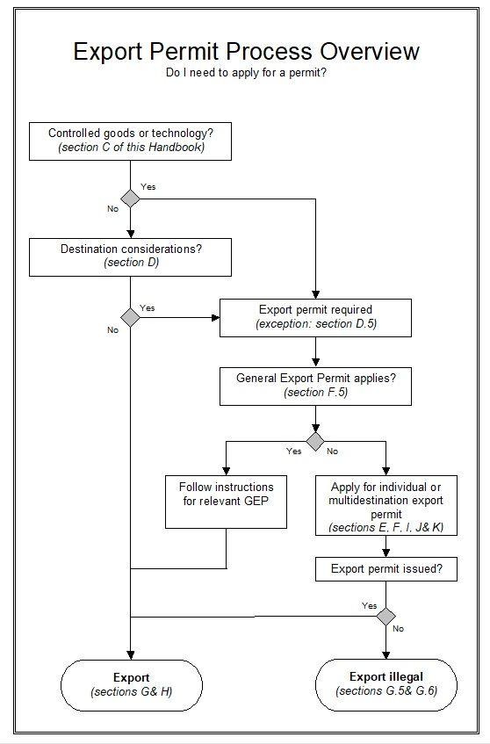
Export Controls – Export Permit Process Overview

Slide 150
Thank You!
Darrel H. Pearson
Partner, Leader of International
Trade and Investment
Bennett Jones LLP
416.777.4811
pearsond@bennettjones.com
Jeff Fraser
Director, Western Region – Canada
Livingston International Global Trade Consulting
780.421.4351 ext. 48602
jfraser@livingstonintl.com

