Slide 1
M&A – What to Expect and How to Prepare
Presented to
Plaza Ventures Summit
May 9, 2018
Gary Solway
Managing Partner, Technology, Media & Entertainment Group
Bennett Jones LLP

Slide 2
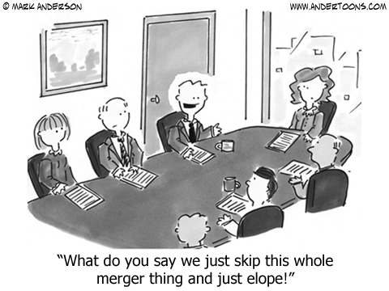

Slide 3
Type of M&A Transaction
For many Cdn private tech companies, objective is a liquidity event
Most tech company M&A transactions are share sales
  asset sales are very rare
Mostly all cash deals paid on closing, with an escrow/holdback
  earnouts
  special management holdbacks
  share exchange

Slide 4
M&A Sale Steps
Prepare confidential information memorandum
Identify potential buyer
  solicited
  unsolicited
Sign non-disclosure agreement (NDA)
Limited diligence
Process to select winning bid (possibly auction)
Sign letter of intent (LOI) granting exclusivity

Slide 5
M&A Sale Steps cont’d
Full diligence
Negotiation of definitive documentation (with Step 7)
Sign and close
  – interim period if approvals required

Slide 6
Structure of Share Sale
Share purchase agreement (SPA) between buyer, target and all shareholders (s/h)
Need all s/h to sign
More s/h = more challenging
Other alternatives requiring s/h holding 2/3rds
Alternatives take longer and can cost much more (e.g. plan of arrangement)

Slide 7
Preparation for Share Sale
Once M&A process starts, things happen quickly
Certain matters need to be completed well in advance
Buyer wants 100% of the equity
  including options, warrants, convertible debt and any other rights
  does not want a minority partner not of its choosing

Slide 8
Preparation Checklist
All options (including ESOP), warrants, convertible debt, SAFEs must provide for termination on M&A share sale
All s/h (including exercising option, etc. holders) subject to a drag along requiring signing of SPA
Avoid material contracts with change of control
Ensure any indebtedness is repayable on a change of control
Prepare electronic data room
  consider super secret information requiring special process
Ensure proper employment contracts in place

Slide 9
Preparation Checklist cont’d
Consider privacy laws re disclosure of employee info
  obtain waivers
Do any personal tax planning (e.g. lifetime capital gains exemption, family trust)
  make sure it will not complicate deal
Ensure ESOP will give desired tax treatment (many tax rules)
Buyers often request a report on open source software or on quality of earnings
  make sure no surprises

Slide 10
Preparation Checklist cont’d
Avoid small s/h who are former disgruntled employees or hard to locate
  need signatures
  need confidentiality
  consider when structuring ESOP
    can be addressed

Slide 11
Preparation Checklist cont’d
Working Capital
  will be price adjustment
  consider calculation in advance for special items (e.g. deferred revenue, cash, SRED)
Cybersecurity, Privacy, CASL, Anti-Money Laundering, Corrupt Practices, Internal Control Practices – often have to give reps on these things, as well as “compliance with laws” – be ready

Slide 12
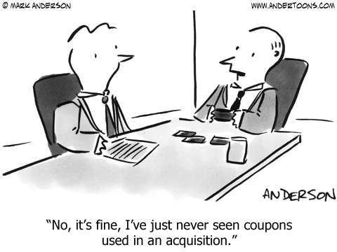

Slide 13
Contractual Exit Rights
Ensure no unanimity required
  ensure no approvals in USA giving veto to small s/h
Dissent rights → take away in USA
  dissent right could apply in some circumstances (such as plan of arrangement)
Ensure USA contemplates sale – rights of first refusal issues

Slide 14
Contractual Drag Along
Permits s/h to force sale if some threshold of s/h wish to sell
Need all s/h signed up
May want to specify some details:
  type of payment → cash only? publicly traded shares? define?
  types of sellers reps → title, residency, what else?
  types of covenants → confidentiality, non-comp?

Slide 15
Contractual Drag Along cont’d
  liability cap
  price to reflect liquidation preference for preferred shares
Power of attorney from s/h to sign/vote if s/h refuse or unavailable
  but POA may not be acceptable to buyer

Slide 16
Due Diligence
Similar to V.C. financing, but often more extensive
Buyer can ask for anything
In addition to legal diligence, will also do business and financial
Will talk to key customers, suppliers, employees

Slide 17
Other Considerations – Red Flags for Buyer
Litigation or tax issues (e.g. sales tax not paid)
Financial statement issues
IP issues
  IP agreements with all employees and consultants
Minute books and corporate records thoroughly reviewed
Related party or non-arm’s length transactions

Slide 18
Other Deal Issues
Founder Holdback/Employment
  Founder/CEO to continue for 2 to 3 years
  move to buyer’s location in U.S. or elsewhere
  special holdback to encourage compliance
Non-compete
  Buyer will want, but VC investors will not give
    compromise is possible

Slide 19
Most Common Reasons for Failed Deal
No agreement on price
Target not as far along as contemplated/represented
Major diligence issue
Other than price, deal terms generally don’t break deals

Slide 20
Deal Team
Arrange deal team in advance
Improves transaction process to have target internal point person
  often CFO
  knowledge of target and authority/relationships
  run numbers, coordinate option exercises, chase signatures
Sometimes accounting firm hired to run numbers, assist with financial diligence and/or do tax

Slide 21
Broker/Agent
Can be very helpful in process
Professional sales person
Can find buyers
Can run auctions
Help keep competitive tension in process
Can talk to buyer’s business team (sellers’ lawyer cannot)
Can preserve relationship between principals
Can run data room
Can run numbers for purchase price calculation and funds flow

Slide 22
Involving Legal Counsel
Earlier the better
Can help with preparation
Can help in negotiation with broker
Can draft NDA with potential buyers
But must involve lawyers at LOI stage
For many key deal points, easier to obtain at LOI stage
Expensive mistakes at LOI stage without advice
  e.g. exchangeable shares, plan or arrangement, working capital

Slide 23
Gary Solway
Managing Partner Technology, Media & Entertainment Group Bennett Jones LLP
Gary advises clients on mergers and acquisitions in the technology space.
Gary has been repeatedly recognized as a leading lawyer in corporate law, securities law, technology law and private equity law by Best Lawyers in Canada, the Canadian Lexpert Directory, the Lexpert/American Lawyer Guide to the Leading 500 Lawyers in Canada and the Lexpert Guide to the Leading U.S./Canada Cross-border Corporate Lawyers in Canada.
Gary has been active as a director or officer of the CVCA since 2001. He is currently Secretary of the CVCA, and Chair of the CVCA's Model Documents Committee.

Slide 24

Thank you
Gary Solway
Managing Partner, Technology, Media & Entertainment Group
solwayg@bennettjones.com
#19698128

