Slide 1
Update on Canada-European Trade
International Compliance Professionals Association
2018 ICPA Canadian Conference
Presenter
Darrel Pearson
Senior Partner and Co-Head, International Trade and Investment Group
Bennett Jones LLP
Presented to ICPA
Hyatt Regency Hotel, Toronto
May 7, 2018

Slide 2
Outline
Update and Primer on Canada-Europe Comprehensive Economic and Trade Agreement (CETA)
UK and Brexit → what next?
Ukraine FTA update

Slide 3
CETA

Slide 4

Canada-EU Comprehensive Economic and Trade Agreement (CETA)
Entered into provisional force on September 21, 2017
Most of the agreement now applies
National parliaments in each EU state must ratify before it comes into full force

Slide 5

CETA – A “Progressive” Trade Agreement
  More than just low to zero tariffs
  Covers services, investor rights and dispute settlement, intellectual property, labour rights, environmental protection, climate action, telecommunications,
  e-commerce

Slide 6
Canada/EU Trade Relationship Snapshot: Canadian Merchandise Trade Flows
Source: Statistics Canada: Imports and Exports, balance-of-payments basis

Slide 7
Canada/EU Trade Relationship Snapshot: Trade Balance

Slide 8
Canada/EU Trade Relationship Snapshot: Exports to EU consistently around 7-8% of Canadian exports

Slide 9
Canada/EU Trade Relationship Snapshot: Effect of CETA
Before CETA, only 25% of EU tariff lines on Canadian goods were duty free – now it is 98%
  will be 99% when fully implemented
Purchasers of EU exports to save $670 million annually in duty payments
Purchasers of Canadian exports expected to save $225 million annually
Important opportunity for Canada to diversify its trade

Slide 10
Canada-EU Trade: Key Sectors
Aerospace
Agriculture and Agri-Food
Automotive
Clean Technologies
Fish and Seafood
Forestry and Wood Products
Information and Communication Tech
Infrastructure
Medical Devices
Metals, Mining and Minerals
Oil & Gas
Pharmaceuticals

Slide 11
"This agreement encapsulates what we want our trade policy to be - an instrument for growth that benefits European companies and citizens, but also a tool to project our values, harness globalisation and shape global trade rules. This trade deal has been subject to an in-depth parliamentary scrutiny which reflects the increased interest of citizens in trade policy.
The intense exchanges on CETA throughout this process are testimony to the democratic nature of European decision making and I expect Member States to conduct an inclusive and thorough discussion in the context of the ongoing national ratification processes of the agreement. Now it's time for our companies and citizens to make the most out of this opportunity and for everyone to see how our trade policy can produce tangible benefits for everyone".
  –Jean-Claude Juncker, President of the European Commission,
  20 September 2017

Slide 12
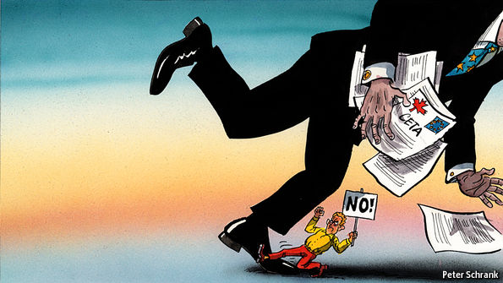
CETA: Path Forward
EU ratification process will take several years
Several EU states may hold referendums on CETA
Belgian ECJ opinion request pending
Contingency plan in event that some EU Member States fail to ratify CETA is unknown
  Likely EU jurisdiction provisions will remain provisionally in force
CETA will proceed regardless of Brexit

Slide 13
CETA: What’s in Force?
Approximately 95% of CETA falls under exclusive EU jurisdiction and is provisionally applied. Including…
  98% of EU tariff lines eliminated
  Non-tariff barriers reduced
  National treatment for trade in services (Chapter 9)
    But not Financial Services, Chapter 13
  Free access to Canadian and EU public procurement markets
  (Chapter 19)
  Temporary entry for business persons (Chapter 10)
  Framework for recognition of worker qualification Chapter 11)

Slide 14
CETA: What’s not in force?
Provisions of “mixed” jurisdiction (EU/member states):
  Investment (Chapter 8), including the Investment Court System dispute resolution
  Financial services (Chapter 13)
  Some administrative procedures from Chapter 27
  Copyright (pirating movies and film)
  Extent of application of Sustainable Development, Environment, and Labour chapters is TBD

Slide 15
Market Access and Trade in Goods (Chapter 2)
Governing principle: National Treatment
Equal treatment of imported and domestic goods
  Duty free importation
  Equal treatment of VAT
Import and export controls not already set out in CETA are prohibited
  e.g. CETA import/export controls do not apply to export of logs from Canada

Slide 16
Tariff Elimination
Also known as: “When Can I Get My Cheap European Wine and Cheese?”
Annex 2-A sets out the schedule for elimination of tariffs
Upon entry into force: 98.2% of Canadian tariff lines and 97.7% of EU tariff lines eliminated
Ultimately: tariffs for 98.6% of all Canadian tariff lines and 98.7% of all EU tariff lines to be fully eliminated
All remaining tariffs brought to zero within the 3, 5, or 7 year timeframe set out in Annex 2-A
98% upon provisional entry
3 years
5 years
99% after 7 years

Slide 17
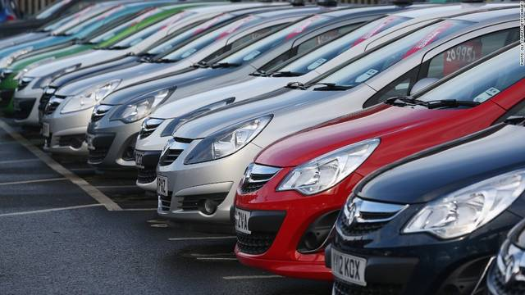
Automotive
Under CETA, EU duty rates on most cars and passenger vehicles are subject to phase outs over 7 years.
Special annual quota (100,000) for passenger vehicles with up to 30% Canadian or EU content (Transaction value) or 20% net cost.

Slide 18
Agricultural Products
Certain sensitive agricultural products excluded from tariff reduction
  Canadian TRQ on dairy including cheese
  EU TRQ on beef, pork, canned sweet corn
  Poultry, eggs are excluded
  EU entry price system (price floors) still applies for some goods
Most Canadian tariff lines for processed agricultural products are duty free (e.g. wines and spirits, pasta, biscuits)

Slide 19


Tariff Rate Quotas (TRQs)
Dairy
  EU open to Canadian dairy
  Canada to provide EU with exclusive cheese quota of 17,700 tonnes + 800 tonnes under EU’s WTO TRQ = Total within access quota 18,500 tonnes
  Double current EU cheese exports to Canada
  Canadian tariff eliminated on milk protein concentrates
Fish and Seafood
  EU provides Canada with transitional duty free quotas for shrimps and frozen cod during tariff elimination period
  (Canada open to EU seafood)

Slide 20
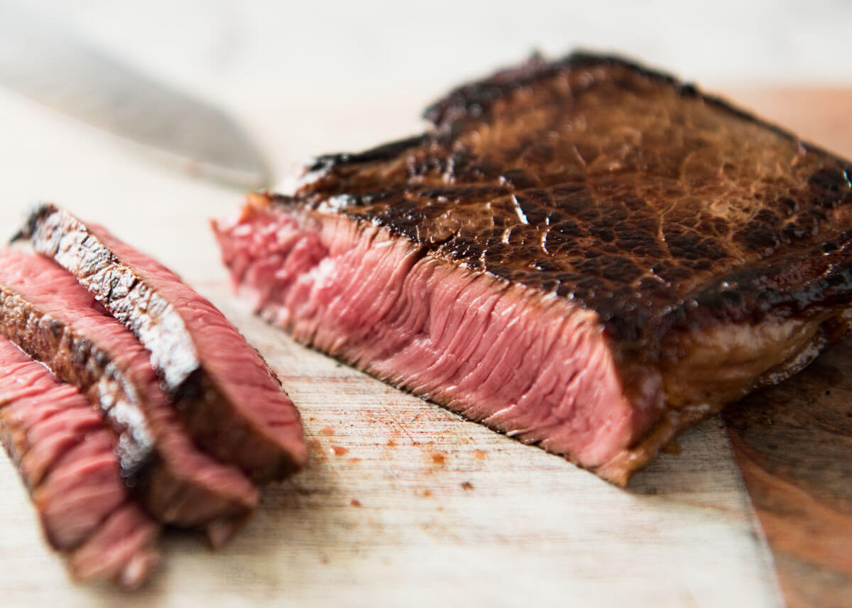


TRQs continued
Canadian beef and pork: EQ TRQ for 45,838 tonnes of beef; 75,000 tonnes of pork (Canada is open to EU beef and pork)
Canadian Wheat:
  EU temporary increase of WTO-TRQ for low and medium quality common wheat (within access) from 38,853 tonnes to 100,000 tonnes while wheat tariffs are fully phased out under CETA (7-year phase out)
  In exchange, Canada eliminated duties on existing WTO TRQs (within access) for EU dairy, eggs and poultry

Slide 21
Tariff Elimination Refund Provisions
General prohibition of Duty Drawback applies three years after CETA enters into force
  Cannot refund, defer or suspend custom duties on inputs imported from a non-Party for export of finished good to a CETA party
  i.e. cannot indirectly support CETA exports through tariff relief on non-party inputs
More restrictive than NAFTA
  NAFTA permits duty drawback of lesser duty paid

Slide 22
Procurement (Chapter 19)
EU and Canadian procurement markets “opened up” and given preferences
  Applies to sub-national governments (municipalities, regions/provinces)
  Canada and EU each have a schedule of carve-outs
    E.g. sensitive services such as water, electricity, natural gas, military procurement
Commitments on transparency and accessibility in procurement process
  Requires creation of electronic portal for procurement submissions
New Canadian Free Trade Agreement (CFTA) (replacing AIT) brings Canada into compliance with its CETA procurement obligations
  New CFTA ensures that Canadian firms secure the same access to Canada’s market as that secured by firms from Canada’s international trading partners

Slide 23

Intellectual Property (Chapter 20)
Protections for EU geographic indicators
  Regional names of types of cheese, cured meats, wine, beer, hops, basalmic vinegar, olive oil, etc.
    Proscuitto di Parma, Roquefort, Pecorino, Aceto balsamico di Modena, Nürnberger Rostbratwürste
  Canadian producers will not be allowed to market their products under the GI names
Other provisions dealing with patent legislation and copyright protection (digital rights standards)

Slide 24

Non-Tariff Barriers – Regulatory Compliance
Mutual recognition of technical certifications based on Conformity Assessments
Examples of currently covered sectors:
  Electrical goods
  Toys
  Machinery
  Measuring equipment
  More categories in consideration for inclusion (e.g. medical devices, gas appliances, rail systems, maritime equipment)
Intended to cut red tape, cut costs from doing multiple tests on same products – Canadian exporters can have their products certified to EU standards by testing agency in Canada, and vice versa.

Slide 25
Trade in Services (Chapter 9)
Far reaching – exceeds bilateral commitments in other agreements
May represent more than half of “value” in the CETA
Reservations for sensitive industries – In addition to insurance and engineering, services such as telecoms, finance, maritime services are not covered
Does not cover public monopolies – e.g. water, health, education
Service exclusions for sensitive sectors: e.g. water, santiation, electrical infrastructure, telecommunications, rail transport
Financial Services chapter (Chapter 13) not in force

Slide 26
Labour Mobility (Chapter 10)
Easier for companies to send personnel between Canada and EU to work for extended periods.
  Establish branches, bid on service contracts, provide maintenance services, etc.
Labour market impact assessment no longer required to obtain temporary entry for:
  Key Personnel including business visitors for investment purposes, investors and intra-corporate transferees
  Contractual Service Providers
  Independent Professionals including self-employed workers
  Short-Term Business Visitors
Periods of temporary entry permits range from 90 days to 3 years depending on the sector

Slide 27
Rules of Origin
Emphasis on simplifying origin procedures
Common approaches for certification, record keeping, and origin verification among importers, exporters, and customs authorities
Protocol on rules of origin and origin procedures sets out most rules
  H.S. classification number is required to find the right ROO
  Annex 5 of the Protocol provides product-specific rules
  Annex 5-A contains derogations (alternative rules) for qualifying products up to specified quotas
Tolerance (de minimis) of 10%

Slide 28
Rules of Origin continued
Tariff-shift base
“Focused Value Method” RVC
  only the value of specific non-originating components is considered
  Minimizes number of materials that must be tracked
“Origin quotas” – more lenient ROO up to a certain volume
Permits cross-cumulation
  will become major advantage if/when TTIP happens
Direct shipment required
  Transshipment only allowed if 3rd country also has an FTA with both EU and Canada

Slide 29
CETA Certification of Origin
Completed and signed by exporter
Submitted by importer to domestic customs authority upon request
Can be statement on an invoice or referencing invoice
Further documentation may be required
May apply to multiple shipments of identical products for up to 1 year
Single origin declaration is sufficient for goods imported in installments
Exporter recordkeeping requirement - 3 years
Verifications and appeal mechanisms

Slide 30
CETA Origin Declaration (Annex 2)
(Period: from___________ to __________)
The exporter of the products covered by this document (customs authorisation No ________) declares that, except where otherwise clearly indicated, these products are of _______ preferential origin.
…………………………………………………………….............................................
(Place and date)
...……………………………………………………………………..............................
(Signature and printed name of the exporter)

Slide 31
CETA Supplier’s Statement of Non-Originating Materials (Annex 3)
Statement:
I, the undersigned, supplier of the products covered by the annexed document, declare that:
The following materials which do not originate in the European Union/in Canada have been used in the European Union/in Canada to produce the following supplied non-originating products.
Any other materials used in the European Union/in Canada to produce these products originate there.
I undertake to make available any further supporting documents required.
…………………………………………………………………………………………………………………………
(Place and Date)
…………………………………………………………………………………………………………………………
(Name and position, name and address of company)
…………………………………………………………………………………………………………………………
(Signature)
1 | 2 | 3 | 4 | 5 | 6
Description of non-originating product(s) supplied | HS tariff classification of non-originating product(s) supplied | Value of non-originating product(s) supplied | Description of non-originating material(s) used | HS tariff classification of non-originating material(s) used | Value of non-originating materials used

Slide 32
Trade Facilitation (Chapter 6)
Chapter 6 sets out objectives and principles for trade facilitation but no binding requirements
Parties shall endeavor to develop
  Simplified release procedures
  Electronic automation
  Cooperation and information exchange “to promote the application of and compliance with the trade facilitation measures in this Agreement”
Nothing requires Canada and EU to implement identical requirements/regulations
“Procedures shall be no more administratively burdensome or trade restrictive than necessary to achieve a legitimate objective.” (6.1(4))

Slide 33
United Kingdom

Slide 34
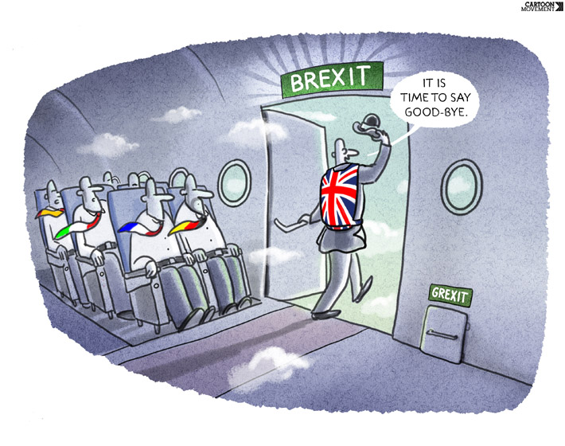
Brexit
Referendum “Leave” Vote: 23 June 2016
  51.9% voted in favor of leaving and 48.1% voted in favor or remaining
  Over 70% of eligible voters turned out
Article 50 Notice to leave: 29 March 2017
23 March 2018: the UK and the EU reached a Brexit transition agreement – extends UK access to single market until December 2020.
Businesses should conduct contingency planning

Slide 35
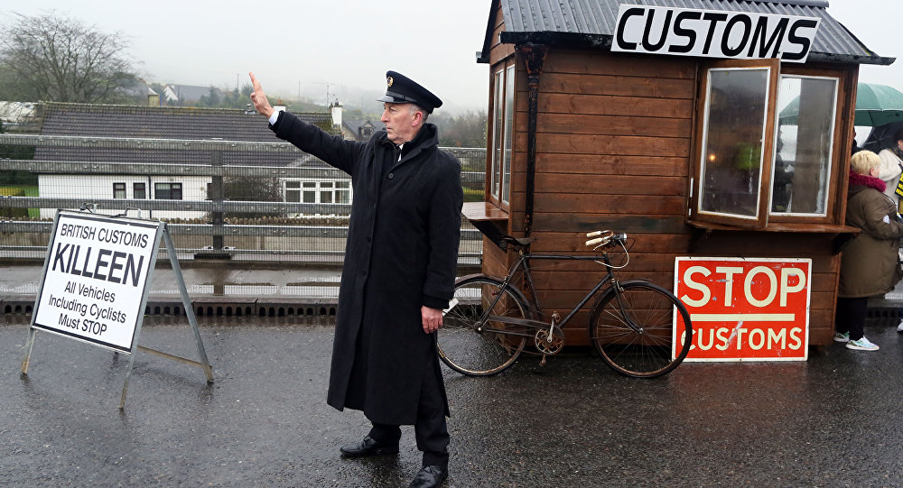
Brexit: What does it mean for UK trade?
UK is currently a full EU Member State and member of Single Market/Customs Union – EEA
After Brexit, UK will be outside Single Market
Must negotiate a bilateral trade deal with EU
  Remain part of Single Market or trade union →”Soft Brexit”
  No deal with EU, WTO MFN will apply → “Hard Brexit”

Slide 36
Brexit: What does it mean for UK trade?
UK has no international treaties of its own
  EU has 759 treaties and international agreements with 168 countries
  UK does not have domestic trade negotiating institutions or expertise
UK cannot conclude its own FTAs while still in the EU
UK must first bring itself into independent compliance with WTO obligations (currently reliant on EU regulation)
Irish border issue

Slide 37
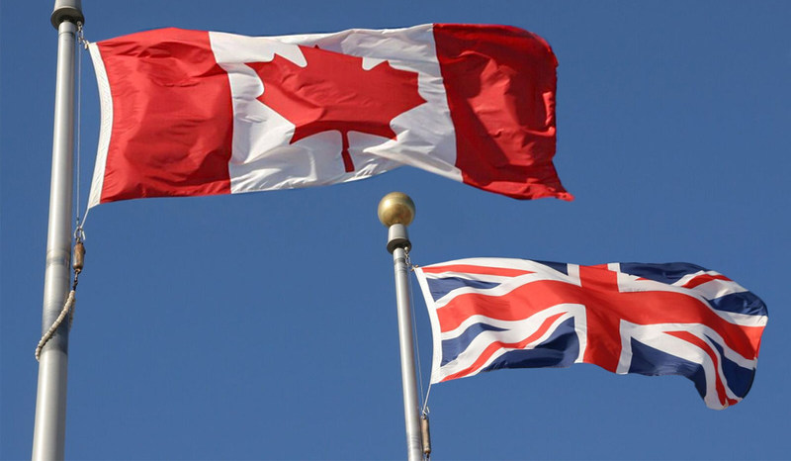
Brexit: Impact on Canada
UK will cease to be a party to CETA
  However, UK could be bound by investment provisions for up to 20 years if UK ratifies CETA before Brexit occurs

Slide 38
CETA as a model?
“I think we can strike a deal as the Canadians have done based on trade and getting rid of tariffs. It’s a very, very bright future I see. What I think we should do is strike a new free trade deal along the lines of what Canada has just achieved. They have taken out the vast majority of the tariffs and have virtually unencumbered trade. We want a relationship based on trade and cooperation. The idea of being subject to the single judicial system is the problem.”
-Boris Johnson, Foreign Minister, 11 March 2016
“[CETA] eliminates all customs duties, which the EU website excitedly describes as worth €470m (£395m) a year to EU business. A similar deal with Britain would save it five times that on cars alone. This would be a perfectly good starting point for our discussions with the commission.”
-David Davis, Minister for Brexit, 14 July 2016

Slide 39
CETA vs EU
The European Union’s Four Freedoms:
  Free movement of goods, capital, services, labour
CETA not a customs union - there remains a border
  CETA commitments on trade facilitation
  Different regulations and customs policies, but must be published electronically, commitments on transparency
  Goods released at the first point of arrival in the importing country
  Option for release before accounting
  Temporary entry, but no free movement of people

Slide 40
“It is fatuous to think there is a real comparison between Canada’s relationship with the EU and the UK’s with the bloc. Indeed, were Canada to trade as much with the EU as we do with the US we would want a much deeper relationship than CETA. When you can rely on trade with the world’s largest economy, as is the case for Canada, you can afford the luxury of time. That will not be the UK’s position.”
–Pierre Pettigrew, former Canadian trade and foreign affairs minister, 15 August 2016

Slide 41
Prospects for Canada-UK FTA?
CETA contemplates integration with other free trade areas with which both parties have qualifying FTAs
  Cross-cumulation
  More lenient transshipment rules
UK to complete FTAs with EU and with Canada with CETA as model?
UK to become third member of CETA?
  Would require amendment
  No accession protocol in CETA except for new members to the EU

Slide 42
Ukraine

Slide 43
Canada-Ukraine Free Trade Agreement (CUFTA)
Canada’s first fully implemented FTA with a European country
Negotiations started in 2010
Signed July 11, 2016
Entered into force on August 1, 2017
Was finalized with backdrop of Crimea conflict
Politically important due to Ukranian-Canadian population
  (Including current Foreign Affairs Minister Chrystia Freeland)

Slide 44
CUFTA
Tariff reduction
  Product-specific rules of origin are found in Annex 3-A
  Transshipment permitted in bond
Reduction of non-tariff barriers; trade facilitation
Government procurement
  MFN access to bid on public airport, railway, mail and public transportation projects
  Ukraine recently launched an online public procurement platform “ProZorro” to provide equal, fair and transparent treatment to bidders
Intellectual property chapter

Slide 45
Canada-Ukraine merchandise trade
Bilateral trade volumes limited: Ukraine is ranked as Canada’s 56th largest trading partner
Approx $298.2 million bilateral trade
  Balance of trade strongly in favour of Canada ($206.8 million are Canadian exports)
Key Canadian exports to Ukraine:
  minerals, live animals and animal products, vehicles, aircraft and associated equipment, pulses, grains, canola oil, processed foods, animal feed, frozen fish, caviar, articles of iron and steel, industrial machinery, plastic products, cosmetics
Key Canadian imports from Ukraine:
  vegetable products, transport equipment and machinery, sunflower oil, sugar and chocolate confectionery, baked goods, vodka, iron and steel, apparel, ceramics, minerals

Slide 46
CUFTA Tariff Elimination
Canada: 98% of tariffs eliminated immediately
  99.9% manufactured products
  all fish and seafood
  99.9% of agricultural imports
  Supply managed products (dairy, poultry and eggs) excluded from Canadian tariff-elimination over existing quota; no quota increases.
Ukraine: asymmetrical phase-out – only eliminated 72% of duties immediately
  TRQ for frozen pork, port offal and fat

Slide 47
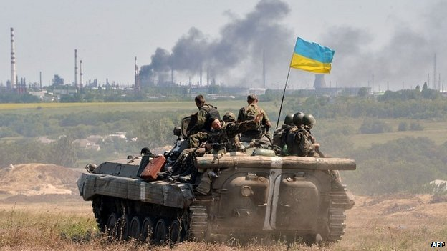
Economic Sanctions on Ukraine
Note that Canada also currently has comprehensive economic sanctions against the Crimea region of Ukraine
Due diligence on customer, end destination and end user is therefore very important

Slide 48


Thank you
Darrel H. Pearson
Senior Partner and Co-Chair,
International Trade & Investment Group
416.777.4811
PearsonD@bennettjones.com
Darrel Pearson

